Slide 1
The Respiratory System

Slide 2
Main Function
To supply O₂ and to remove CO₂
O₂ is supplied to the body
O₂ transported to body cells
Body cells use O₂ and release CO₂
Circulation
Respiration
Breathing (inhale)
CO₂ waste is expelled
Co₂ is transported to lungs
Breathing (exhale)
Circulation

Slide 3
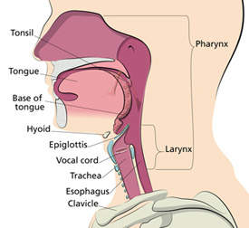
Parts of the Respiratory System
Pharynx- food, liquid and air share this passage

Slide 4
Epiglottis
flap that stops food from entering airway

Slide 5
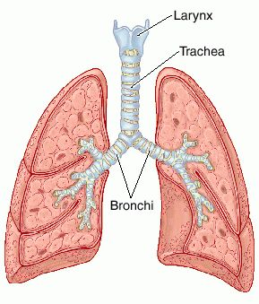
Larynx
directs air through vocal cords

Slide 6
Trachea
Passageway for air

Slide 7
Bronchi
Take air into and out of the lungs

Slide 8
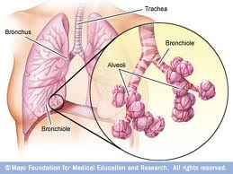
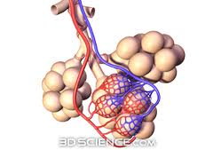
Alveoli
Provide places for O₂ and CO₂ to be exchanged

Slide 9
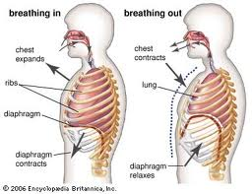
Inhaling vs. Exhaling
Inhaling-diaphragm contracts and air is drawn into the lungs
Exhaling-Diaphragm relaxes and gases are expelled from the lungs

