Slide 1
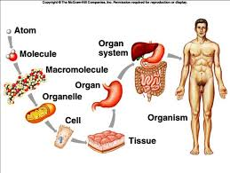
Organism
Define organism
What are organisms made of?
Copy pg. 103 figure 5 # 1
Color and glue Organism picture onto circle

