Slide 1
Welcome!
Bellwork:
  Take out your notebook
  Complete the Pre-test on your small sheet of paper
  Remember, this is NOT graded. This is meant for you to see how much you know.
  You will have until 2 minutes after the bell rings

Slide 2
Pre-test Answers
Grade your pre-test
Pre-test answers

Slide 3
Scale Score
Open your notebook to a new page.
Title it: Unit 6-Controlling body processes
GOAL

Slide 4
Scale Score
Look inside your group binder to find the new Unit 6 Scales
Study the scale carefully, then decide what scale score you are currently at and why

Slide 5
Scale Score
Draw a scale and shade/date your current place on it
Write/answer these questions:
  Current score:
  Score Goal:
  2 specific things I will do to reach my goal:

Slide 6
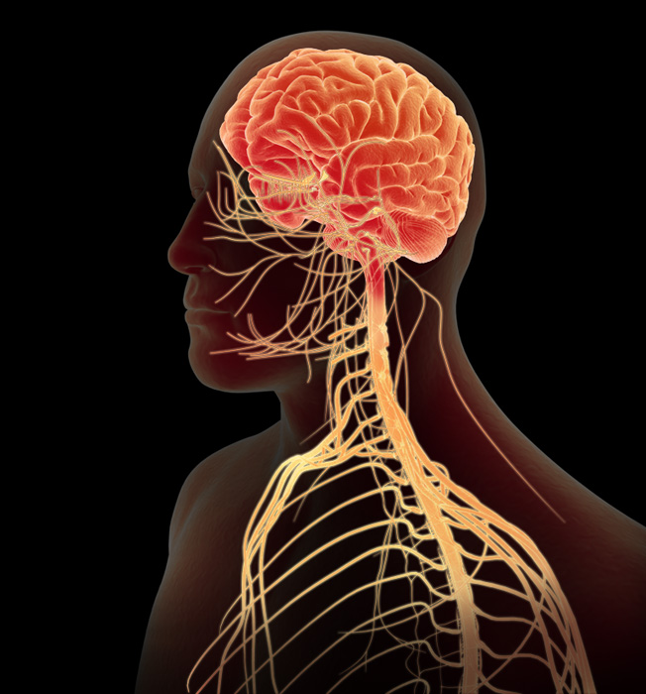
Today’s Learning Goals:
Identify and describe the body parts of the nervous system and their functions
Explain how the nervous system helps the body maintain homeostasis

Slide 7
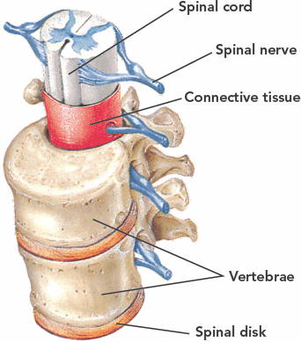
Role of the Nervous System
Receives information about what is happening inside and outside your body.
Directs how your body responds to information

Slide 8
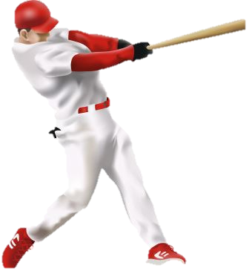
How do you Respond to information?
Any signal from the outside environment that you can react to is called a stimulus (plural is “stimuli”)
Our nervous system can help us respond to stimuli in 2 ways
  Voluntary: we choose to respond, like swinging a bat
  Involuntary: the response is out of our control, like when you are cold and you shiver

Slide 9
How do we sense stimuli?
Neurons (nerve cells)-cells that carry information through your nervous system
This information is called a nerve impulse.
Bundles of nerve fibers make up a nerve

Slide 10
the information a cell carries is called…
A neuron
A stimulus
A nerve impulse
A synapse

Slide 11
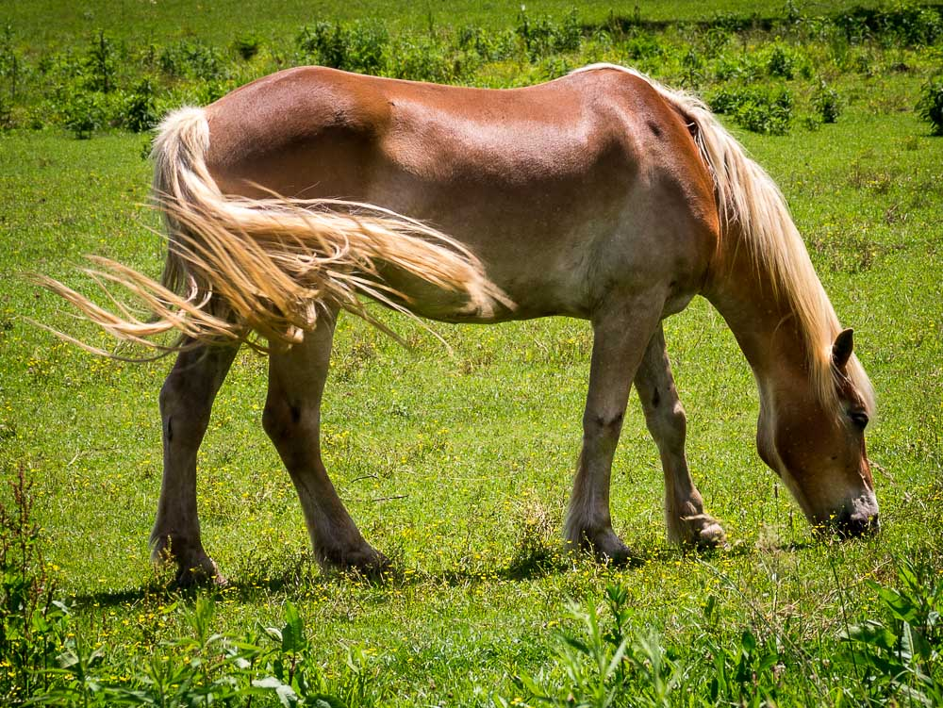
When a horse flicks its tail to swat a fly, it is responding to…
A nerve impulse
A stimulus
A reaction
A brain signal

Slide 12
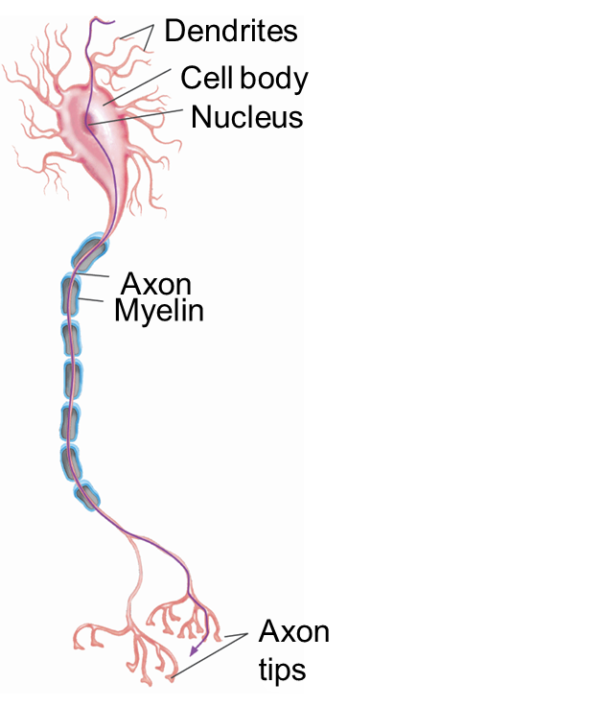
How Do Impulses Travel Through the Body?
Dendrites receive impulses from other neurons and sends them to the cell body
The axon carries impulses away from the cell body, through the axon tips to other cells

Slide 13
Figure 2, page 235
Complete Figure 2
You will have 3 minutes
Be ready to share your answers!

Slide 14
Types of Nerve Cells
Sensory Neuron-picks up stimulus to convert to nerve impulse
Interneuron-carries stimulus to another interneuron or to a motor neuron-most found in brain or spinal cord
Motor neuron-sends an impulse to a muscle or gland, allowing it to respond.

Slide 15
Where do nerve impulses enter a nerve cell?
A
B
C
D

Slide 16
Which type of neuron is usually found in the brain or spinal cord and carries impulses to other neurons?
Sensory
Interneuron
Motor
Auxiliary

Slide 17
Central and Peripheral Nervous systems
The nervous system has two sub systems that work together to run the whole system:
  Central Nervous System: made up of the brain and the spinal cord
    The spinal cord controls reflex responses
    The brain has 3 main parts

Slide 18
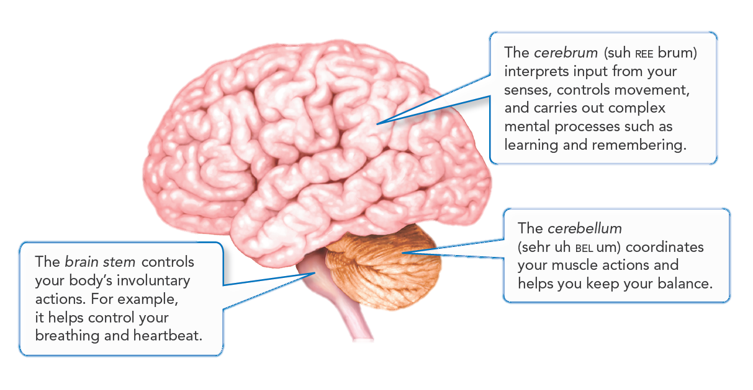

Slide 19
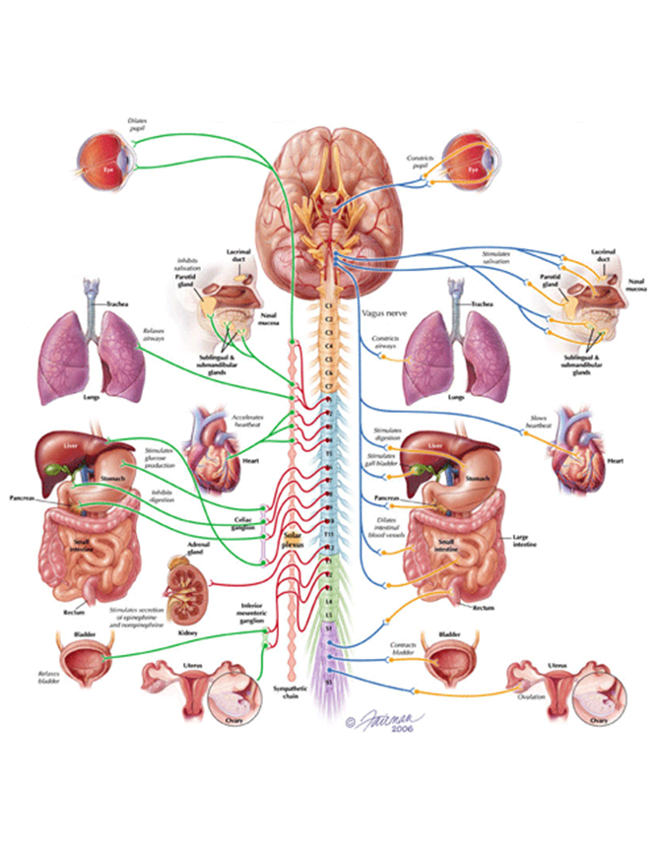
Peripheral Nervous system
  Peripheral Nervous System: made up of all nerves outside the central nervous system
Somatic controls voluntary actions
Autonomic controls involuntary actions

Slide 20
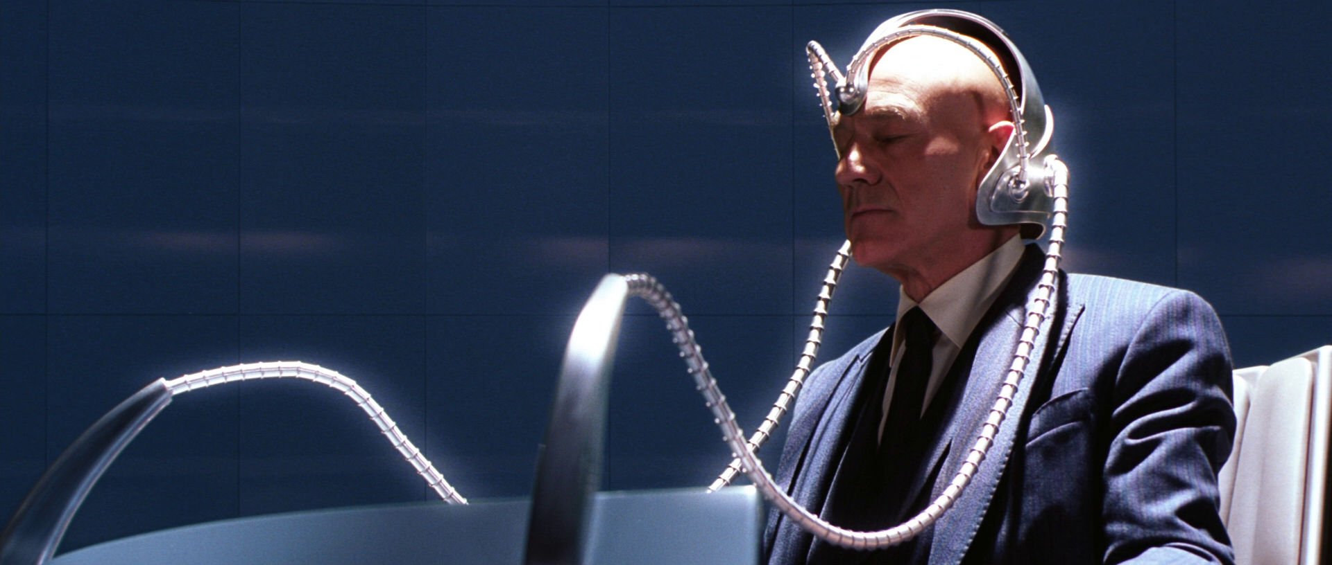
You will have to use this part of your brain to remember which part helps you remember
Brain Stem
Cerebellum
Hippocampus
Cerebrum

Slide 21
The voluntary action of playing a piano is controlled by:
The somatic nervous system
The autonomic nervous system
The central nervous system
The pentatonic nervous system

Slide 22
Wrap Up:
Goal: Explain how the nervous system helps the body maintain homeostasis
The nervous system helps the body maintain homeostasis by directing your body to respond properly to information it receives

