Slide 1
Happy Friday!
Bellwork:
Please open your notebooks and copy down the graphic organizer (you can find it in your group binder)
You may trace it if you want. Make sure you also outline the boxes with the correct colors.

Slide 2
Today’s Goal
Be able to recognize that there are a finite number of elements that make up everything
Describe how matter can be broken down into smaller and smaller parts and how these parts can combine to make different materials.

Slide 3
What is Matter?
Anything that has mass and takes up space
This includes solids, liquids and gases
AKA: Stuff

Slide 4
Anything that has mass and takes up space

Slide 5
Elements, Atoms, molecules, oh my!
Element: a substance that cannot be broken down into any other substances by chemical or physical means.
There are over 100 known elements
Each element has a 1 or 2 letter abbreviation
Ex: oxygen is O, and Calcium is Ca
Atom: the basic particle from which elements are made.
Molecule: a group of two or more atoms held together by chemical bonds.

Slide 6
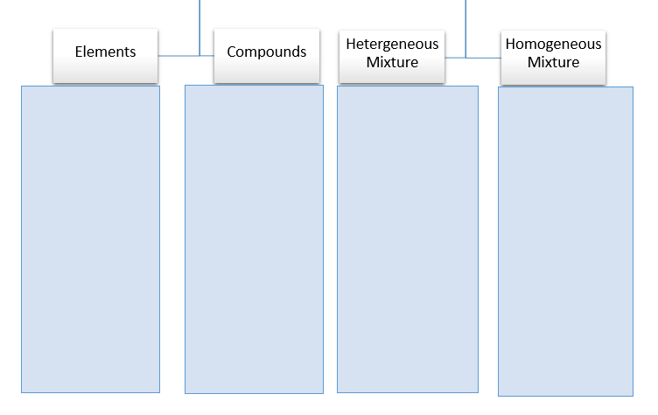
a substance that cannot be broken down into any other substances by chemical or physical means

Slide 7
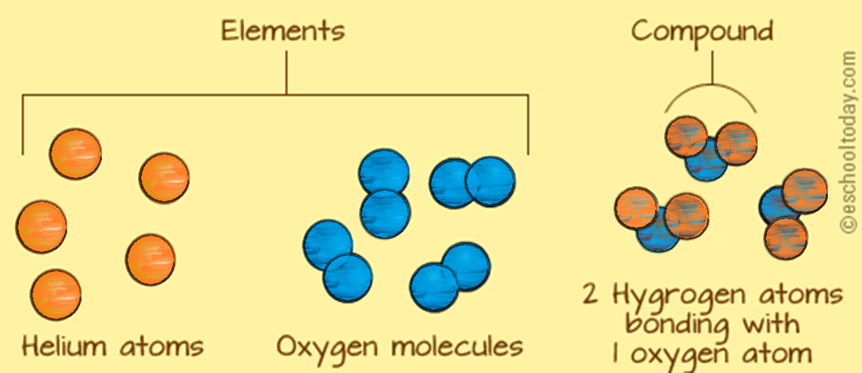
The element of Helium is made of a single Helium atom. Written as H.
Oxygen molecules are made of 2 bonded oxygen atoms. Written as O₂
The compound water is made of two elements: H and O₂. Together, the make H₂O

Slide 8
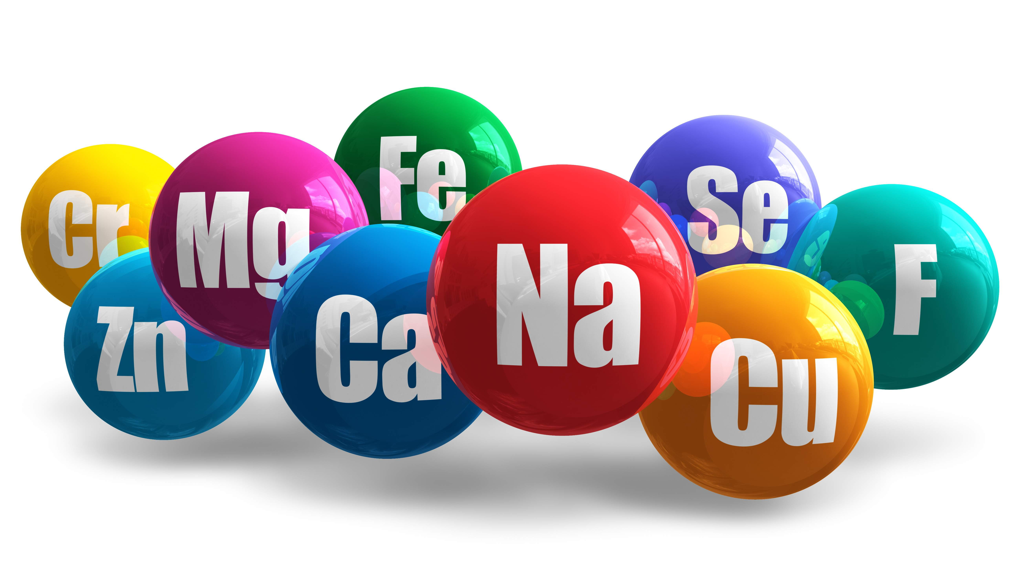
Figure 2
Complete Figure 2 on page 97 of your new packet!

Slide 9
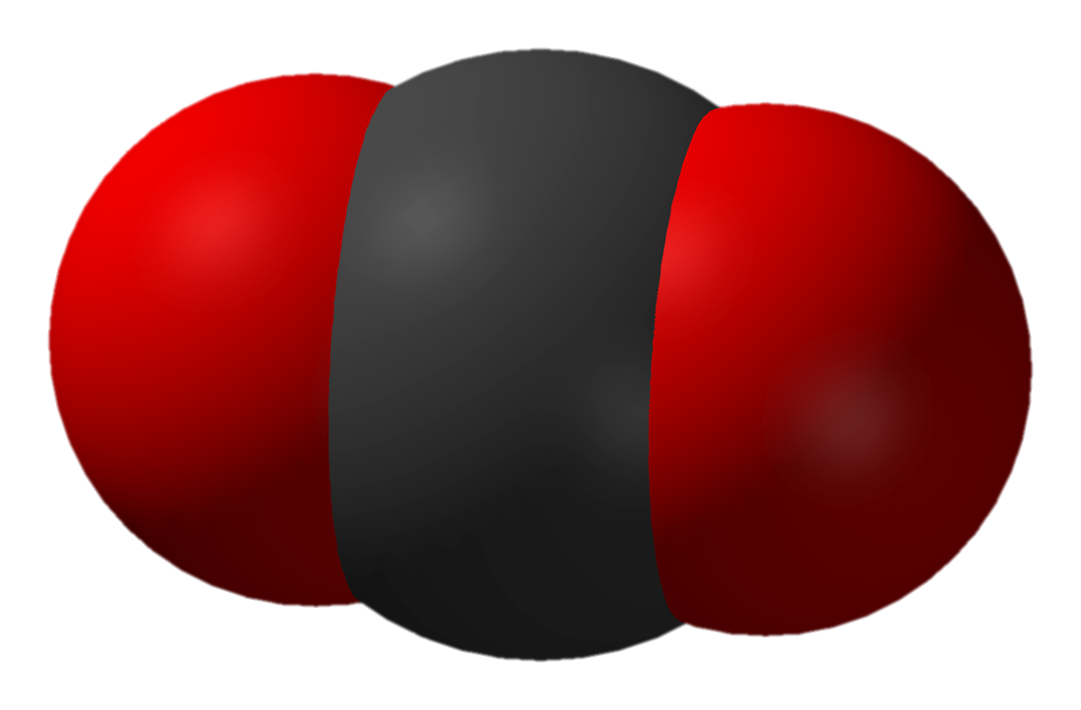
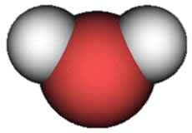
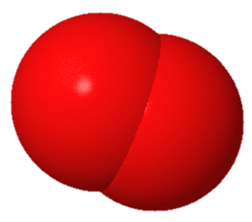
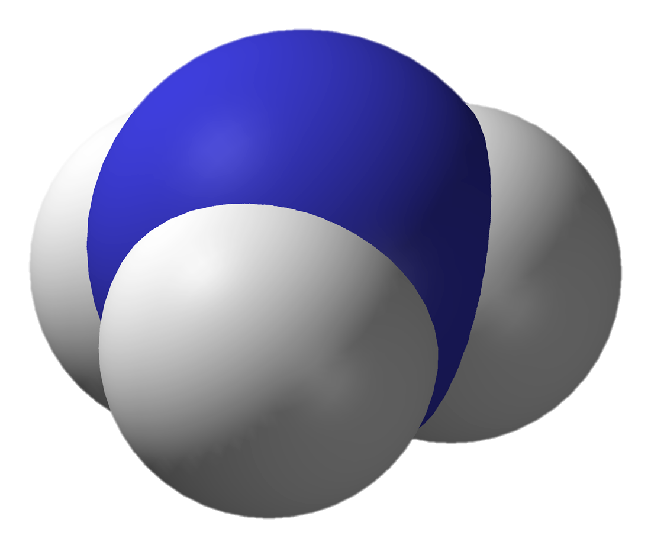
Figure 2
Carbon Dioxide
2 oxygen atoms
1 carbon atom
CO2
Water
2 hydrogen atoms
1 oxygen atom
H2O
Oxygen
2 oxygen atoms
O2
Ammonia
3 hydrogen atoms
1 nitrogen atom
NH3

Slide 10
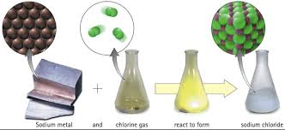
Compounds
A substance made of two or more elements that are chemically combined in a set ratio
Ex: Water (H2O), ammonia (NH3), and carbon dioxide (CO2)
So, in water, there are always 2 hydrogens to 1 oxygen

Slide 11
But what is a substance?
A substance that cannot be broken down into any other substances by chemical or physical means
A substance made of two or more elements that are chemically combined in a set ratio

Slide 12
Anything that has mass and takes up space
Elements and compounds that have not been mixed with other elements and compounds

Slide 13
Mixtures
When 2 or more substances combine together in the same place, but their atoms are not chemically bonded, this is a mixture.
Mixtures do not have a set ratio like a compound
The substances in the mixture retain (keep) their own properties

Slide 14
Anything that has mass and takes up space
There are 2 types of mixtures!
Elements and compounds that have not been mixed with other elements and compounds
When 2 or more substances combine together in the same place, but their atoms are not chemically bonded

Slide 15
A substance that cannot be broken down into any other substances by chemical or physical means
A substance made of two or more elements that are chemically combined in a set ratio
You can usually see the different parts, and they can be separated
Substances are so evenly mixed that you cannot see the different parts. It is difficult or impossible to separate.

Slide 16
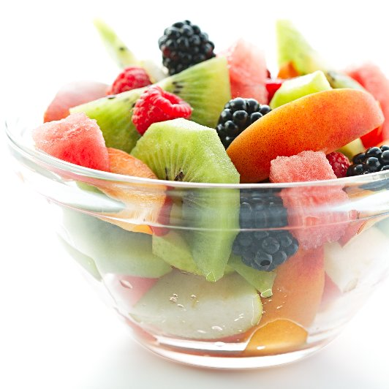
Complete Figure 4!
Determine whether these 3 items are heterogeneous or homogeneous mixtures!

Slide 17
Have a great Weekend!

Slide 18
Welcome!
Bellwork:
Create your own graphic organizer to show the organizational structure of matter
Include these terms:
Matter
Element
Atom
Molecule
Substance
Mixture
Heterogeneous
Homogeneous

Slide 19
Today’s Goals
Today we will learn:
How a solid, liquid and gas is described
What happens to a solid as it melts
What happens to a substance that becomes a gas

Slide 20
Solids
Particles (atoms) in solid objects are in a fixed, closely packed arrangement. This causes it to have a definite shape and volume.
A solid does not fit the shape of its container, it retains its form.
Two types- crystalline and amorphous

Slide 21
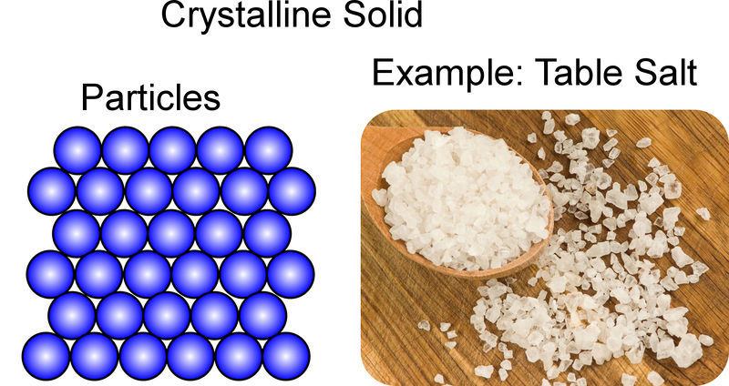
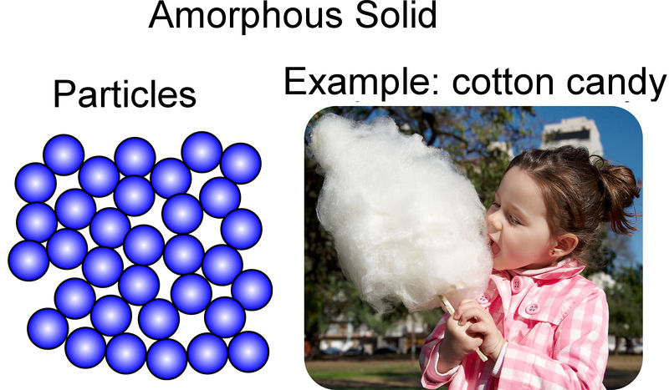
Types of Solids
Crystalline
particles form a regular repeating pattern- these form crystals
When heated, it melts at a specific temperature
Amorphous
Particles are not arranged in a regular pattern
No distinct shape
Does not melt at a distinct temperature- may melt, become softer or change

Slide 22
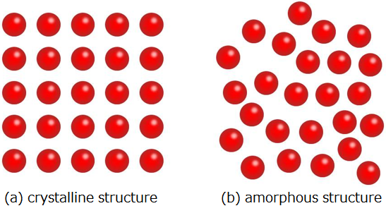

Slide 23
Crystalline or Amorphous? Plastic ball pit balls
Amorphous

Slide 24
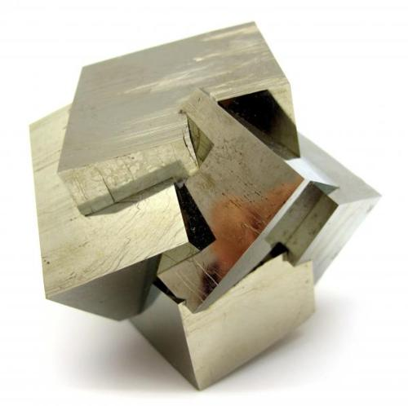
Crystalline or Amorphous? Pyrite (Fool’s Gold)
Crystalline

Slide 25
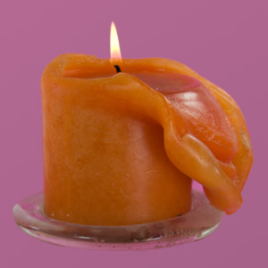
Crystalline or Amorphous? Candle
Amorphous

Slide 26
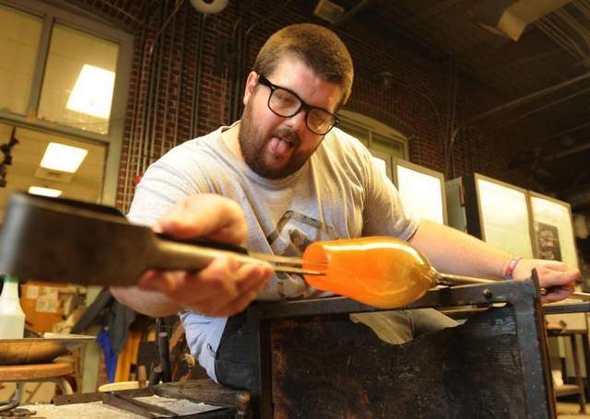
Crystalline or Amorphous? Glass
Amorphous

Slide 27
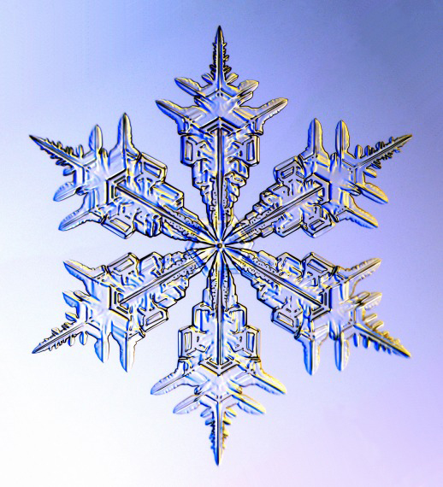
Crystalline or Amorphous? Snow Flake
Crystalline

Slide 28
Liquids
Has definite volume, but no shape
Particles are packed tightly, but are able to freely move around each other
Liquids are able to flow and take the shape of their containers

Slide 29
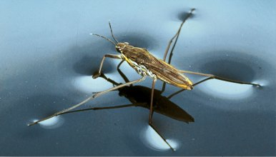
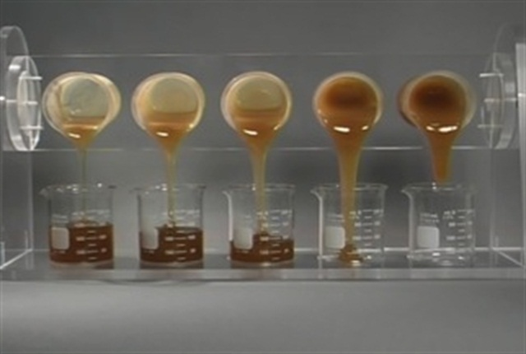
Properties of Liquids
Surface Tension:
Viscosity:
an inward force, or pull, among the molecules in a liquid that brings the molecules on the surface closer together.
a liquid’s resistance to flowing
Water and vinegar have low viscosity, meaning that they flow easily
Honey has a high viscosity, it flows sloooowwwlllyyyy.

Slide 30
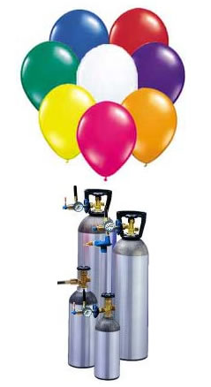
Gases
No definite shape
No definite volume
Gas particles move in all directions and fill the shape and volume of their container.

Slide 31
Pressure
The force of a gas’s outward push divided by the area of the walls of the container
Pressure is measured in units called Pascals (Pa)
Pressure= Force/Area

Slide 32
Figure 6 & Do the math!
Complete them!

Slide 33
See you tomorrow!

Slide 34
Melting
Melting is the change in state from a solid to a liquid
This is a physical change

Slide 35
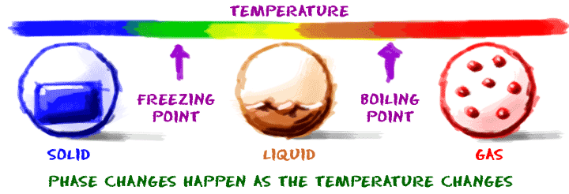
Freezing and Boiling Point

Slide 36
Properties of water
https://www.youtube.com/watch?v=aVmU3CLxvgU

