Slide 1
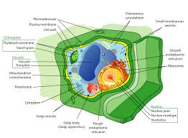
Cells
Define cells
Tell what cells are made of
Give examples of cells
Where can they be found
Cut out, color, and glue the cell picture onto circle
Plant Cell

