Slide 1
Welcome back!
I hope you all had a nice weekend!
Bellwork:
Begin a new page in your notes. Title it “Cell Division”. Write and answer this question on the second line of the page: Why do cells divide?
After you answer, complete the My Planet Diary on page 124

Slide 2
Take out your Scale Tracking Sheet
Review the scale in your group binder.
Where do you think you are in your understanding now?
Rate yourself on your scale tracking sheet.

Slide 3
Learning Goals
Understand and identify the functions of cell division
Describe what happens during the cell cycle

Slide 4
Why do cells divide?
Cells divide for several reasons:
Growth
A tadpole cannot become a frog unless its cells are dividing and increasing in number
Repair
If you break a bone or sustain an injury, your cells must divide to replace damaged cells with healthy ones
Reproduction
To create the next generation, special types of cells divide many times to generate a new organism

Slide 5
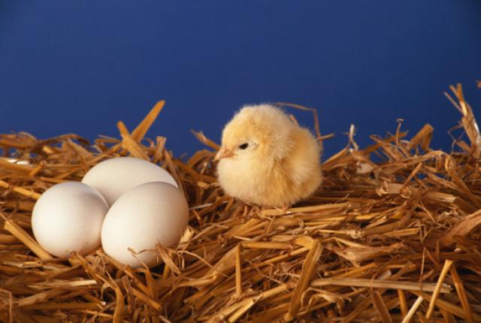
When a baby bird grows into an adult, what function of cell division is this?
Growth
Repair
Reproduction
Strength

Slide 6
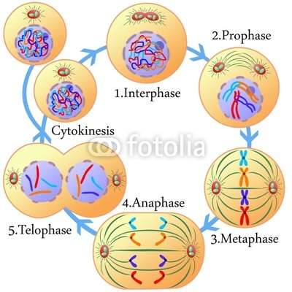
The Cell Cycle
The Cell Cycle is the process when a cell grows, prepares for division, and divides into two new cells. These are called daughter cells

Slide 7
Asexual vs. Sexual Reproduction
Asexual-offspring form from one parent
Sexual –Offspring form from two different parents

Slide 8
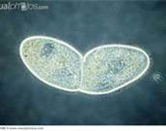
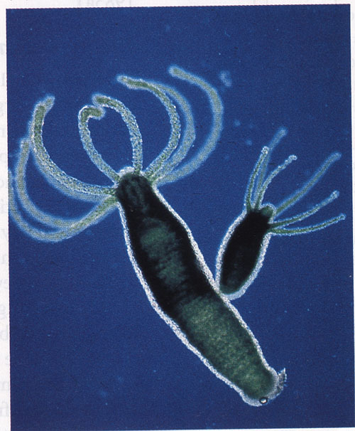
Asexual Reproduction
Binary fission-one organism divides into two Ex. Bacteria
Budding—a small, exact copy of the adult grows from the body of the parent.
Regeneration, a whole new organism grows from each piece of the parent.

Slide 9
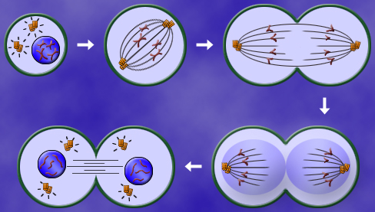
How do cells duplicate?
Mitosis
Sexual
46 chromosomes in humans replicated
Nonsexual
Ex. Bone, brain, skin

Slide 10
This type of reproduction requires only one parent
Binary
Asexual
Mitosis
Sexual

Slide 11
When an organism grows a smaller version of itself off the body of the parent.
Binary Fission
Budding
Regeneration
Mitosis

Slide 12
What is replication?
Exact copy of DNA in cell’s nucleus
Cell contains 2 sets of chromosomes at end of replication
In animal cells, centrioles help cell divide

Slide 13
Interphase
Period before cell division
Cell grows, makes a copy of its DNA, and prepares to divide

Slide 14
Figure 2
Page 126
Interphase

Slide 15
Prophase
Chromosomes condense or become thicker
Centrioles move to opposite sides of nucleus
Spindle fibers form a bridge
Nuclear membrane disappears
spindle
centrioles

Slide 16
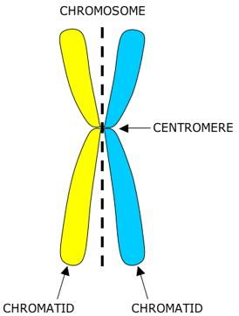
Metaphase
Chromosomes move to center of cell and attach to a spindle at its centromere

Slide 17
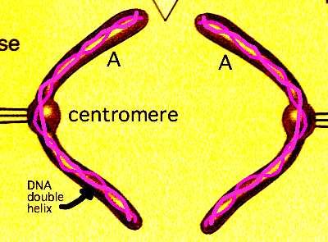
Anaphase
Centromere splits, pulling chromatids apart
Chromosomes travel to opposite ends of cell

Slide 18
Telophase
2 new nuclei are formed
Spindle disappears
Cell is pinched around middle
CYTOKINESIS-2 new daughter cells are formed with identical number of chromosomes as parent

Slide 19
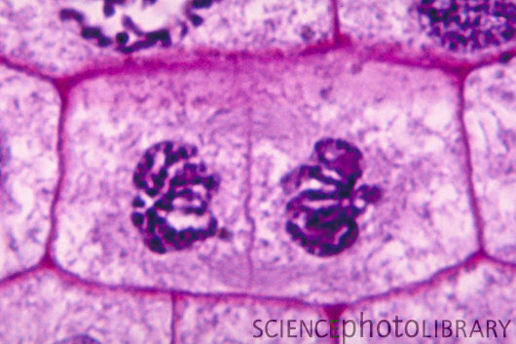
Animal Cell vs. Plant Cell
Centrioles in animal cell only
CELL PLATE forms in plant cell because of cell wall

