Slide 1
The Skeletal System

Slide 2
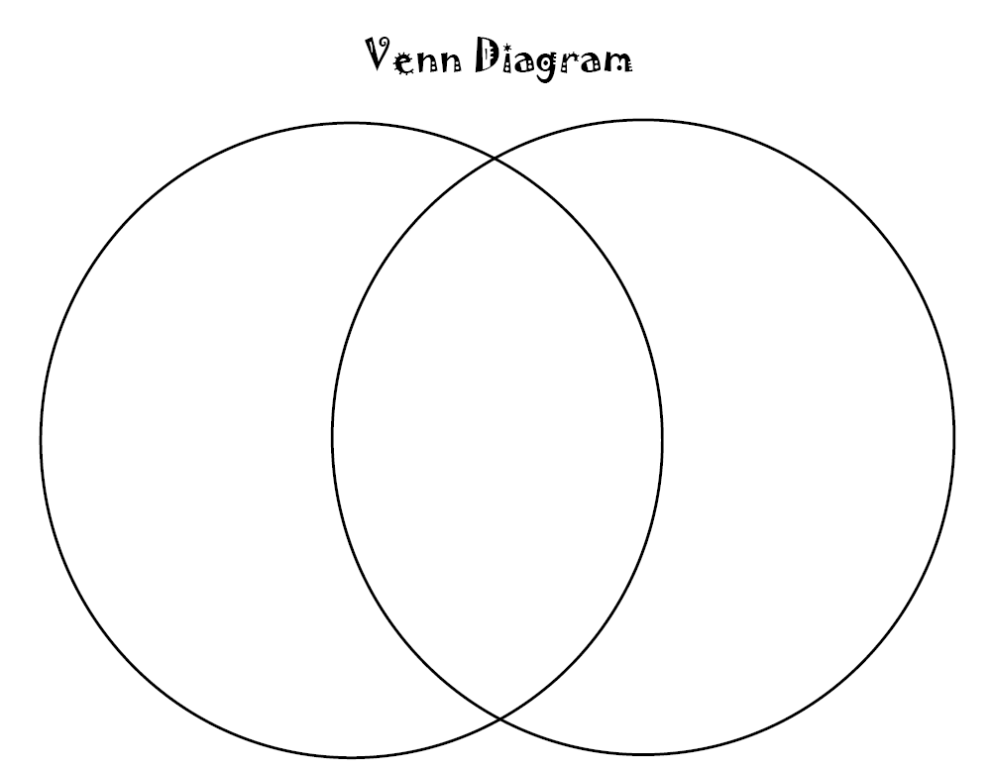
Bellwork: Create a Venn diagram comparing the similarities and differences between Rocks and Bones.

Slide 3
Learning Goals
During this lesson we will learn:
The function of the skeleton
The role that joints play in the body
What characterizes bones

Slide 4
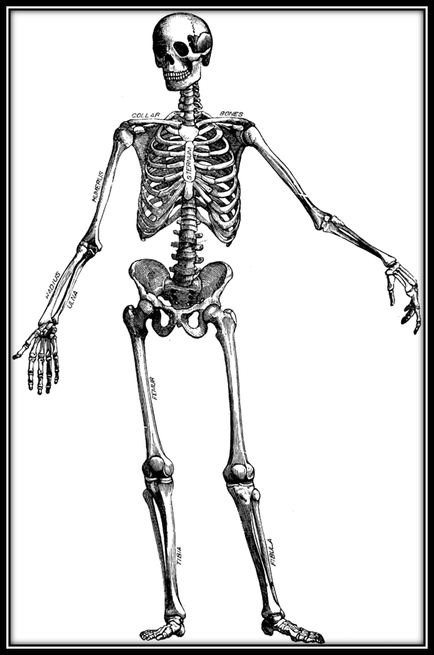
What is a skeleton?
I have 206 bones in all!
A skeleton is the body’s inner framework that is made up of bones (P. 163).

Slide 5
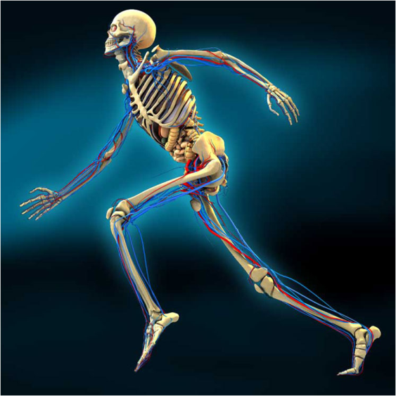
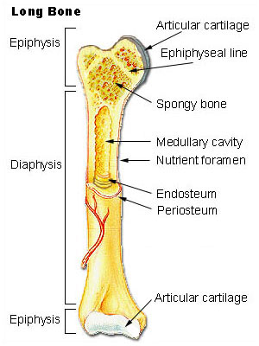
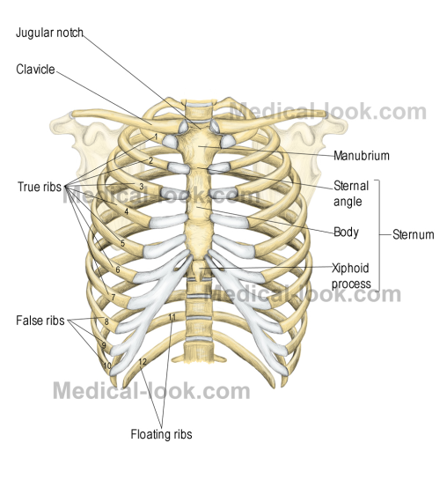
Major functions of the skeleton
Enables you to move
Provides shape and support
Protects organs
Store minerals
Produce blood cells

Slide 6
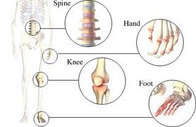
What are Joints?
Joint- place where 2 bones come together and allows bones to move in different ways
Immovable-Connects bones and allows little or no movement. Ex. Skull

Slide 7
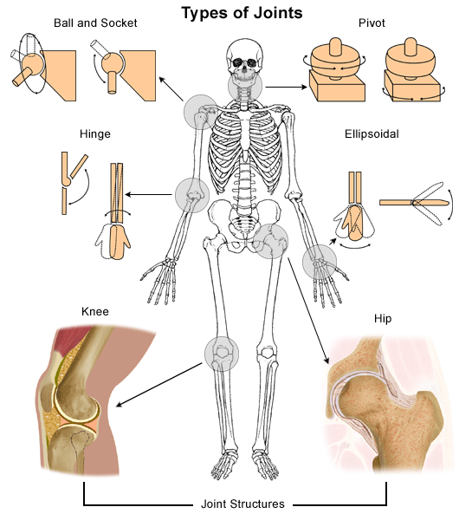
Movable-most are moveable; held together by ligaments
1. Ball and socket-shoulders, legs
2. Gliding-wrist, ankle, vertebrae
3. Hinge-knee, elbow, jaw
4. Pivot-turning head

Slide 8
Brainpop!
Joints!

Slide 9
Review the Goals
The function of the skeleton
Enables you to move
Provides shape and support
Protects organs
Store minerals
Produce blood cells
The role of joints
Joints allow bones to move in different ways
There are 2 main types: Immovable and Moveable
Moveable joints are held together by ligaments

Slide 10
Which of these is not a function of the skeleton?
Provide shape and support
Protects organs
Produces red blood cells
Sends waste products out
Stores minerals

Slide 11
What substance do bones Produce?
Spinal Fluid
Brain Tissue
Red Blood Cells
White Blood Cells
Rainbow Blood Cells

Slide 12
What is the best example of what joints allow your body to do?
Belch
Climb a tree
Smell a delicious pie
Call out to your friend
Remember to complete an art project

Slide 13
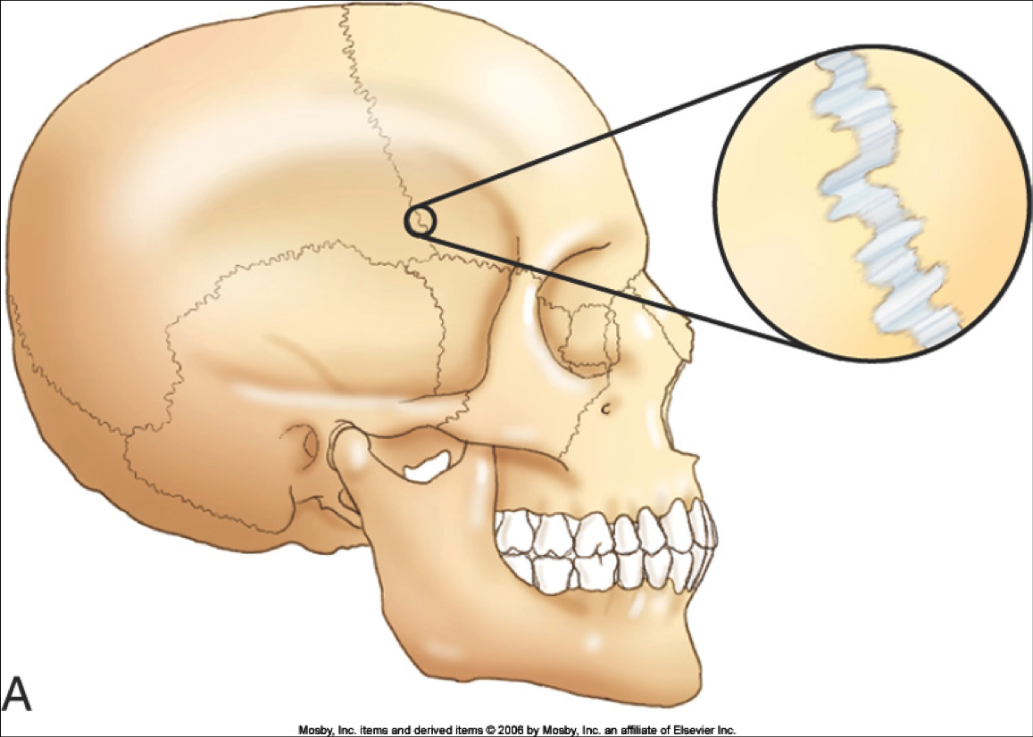
Your skull is an example of this type of joint
Moveable, because it moves
Moveable, because it does not move
Immovable, because it moves
Immovable, because it does not move

Slide 14
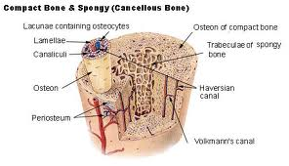
What are bones?
Bones- complex living structures that:
grow
develop
repair themselves
They are strong and light weight

Slide 15
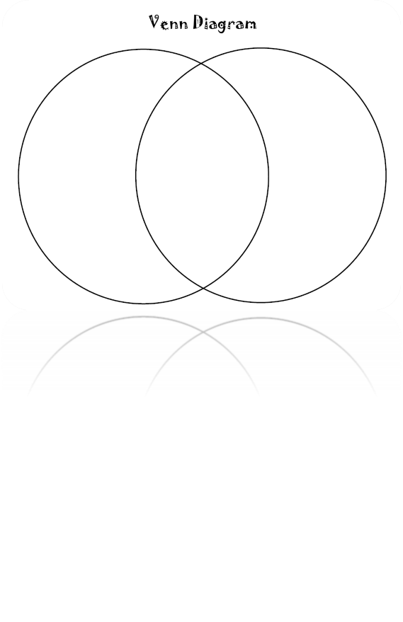
Venn Diagram
Go back to your Venn Diagram from the beginning of class.
With what you now know about bones, would you change anything on your diagram?
Discuss with your shoulder partner and make the changes.

Slide 16
Review the Goals
What Characterizes bones:
Bones are complex living structures that:
grow
develop
repair themselves
They are strong and light weight

Slide 17
Bones are characterized as:
Strong and Dense
Strong and Lightweight
Flexible and Spongy
Flexible and Lightweight

Slide 18
What are 1 of the characteristics of a bone?
Send Messages to the Brain
Waste Removal
Digestion
Repair Themselves

Slide 19
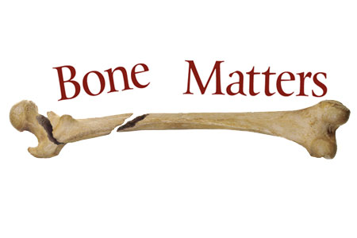
Have a great weekend!
Homework: Read and complete figures for pages 162-165 in your Chapter 4 book packet.

