Slide 1
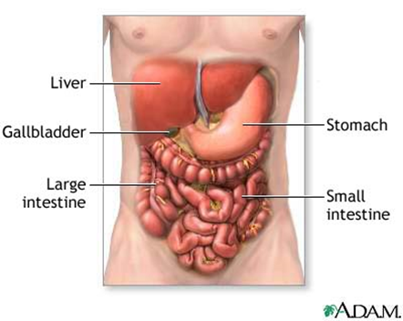
Organ System
Define Organ System
What is an organ system made of?
What is the function of an organ system?
Glue Organ System picture onto circle

