Slide 1
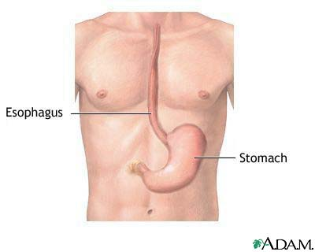
Organ
Define organ-
What are organs made of?
Give an example of an organ
Glue, and color organ picture onto circle

