Slide 1
Welcome!
Bellwork:
Complete Figure 1 on page 301

Slide 2
How does Light travel?
Light waves travel in straight lines from the light source
Depending on the material it contacts, it can behave in different ways

Slide 3
Opaque
An opaque material is one that we cannot see through.
Light cannot pass through these materials/objects.
When light hits an opaque object, some light is absorbed and the rest is reflected off

Slide 4
Opaque Objects
Cactus
Tortillas
A block of wood
A couch
A chinchilla

Slide 5
Transparent
Transparent objects or substances allow light to move easily through it, it is not reflected or absorbed
We can see through transparent objects and materials

Slide 6
Transparent Objects
A clear ornament
A fish bowl
A crystal
Eye glasses
Clear marbles

Slide 7
Translucent
Translucent materials and objects are semi-clear, allowing us to see an image, but not clearly
Light passes through the object, but most is reflected in different directions (diffused)

Slide 8
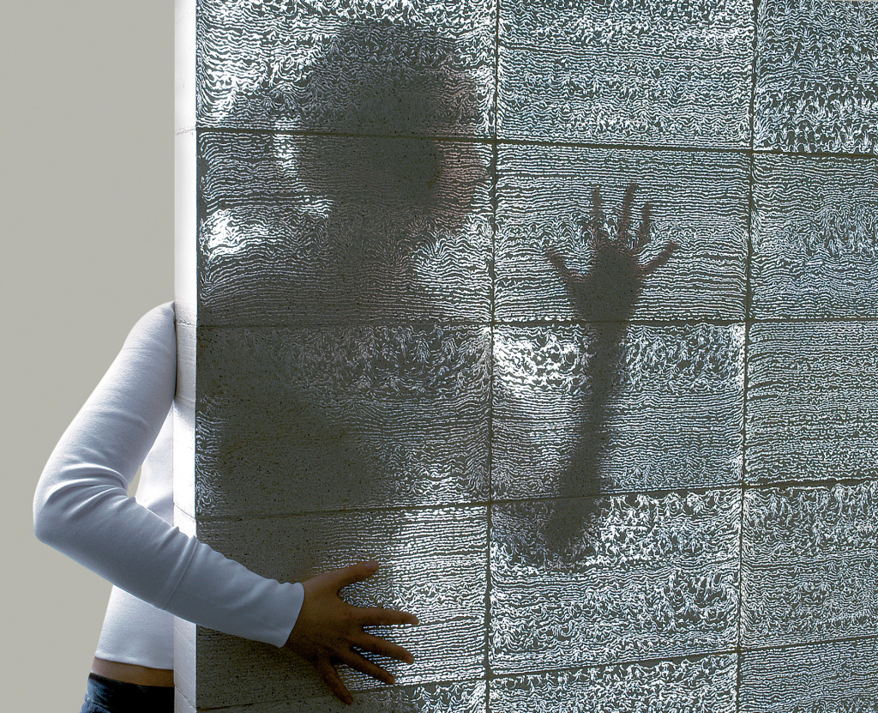
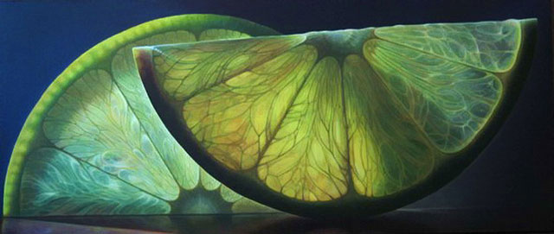
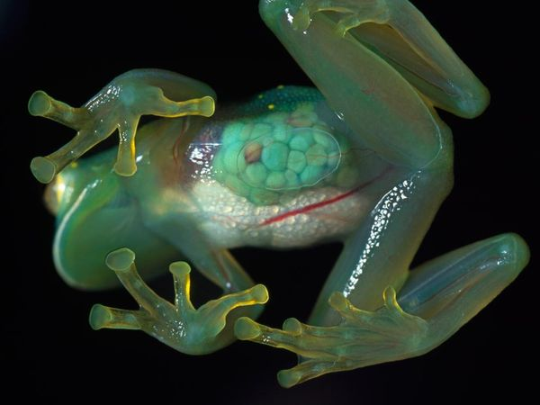
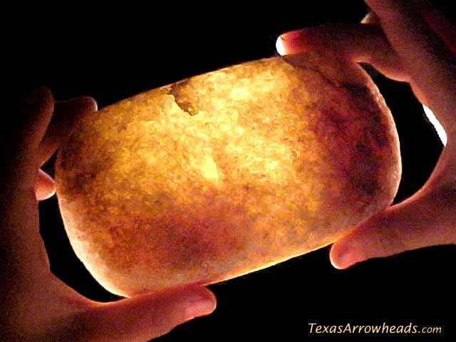
Translucent objects

