Slide 1
Muscular System and Skin

Slide 2

Happy Tuesday!
Bellwork:
  Take out your homework for me to look at. Flip to page 163.
  Copy and answer the following in your notebook:
    What are the differences between the movement of a hinge joint and a ball-and-socket joint?
    Describe what could occur if your skull were connected by movable joints.
    Name the 3 characteristics of bones. Describe a time when your bones did one of these things.

Slide 3
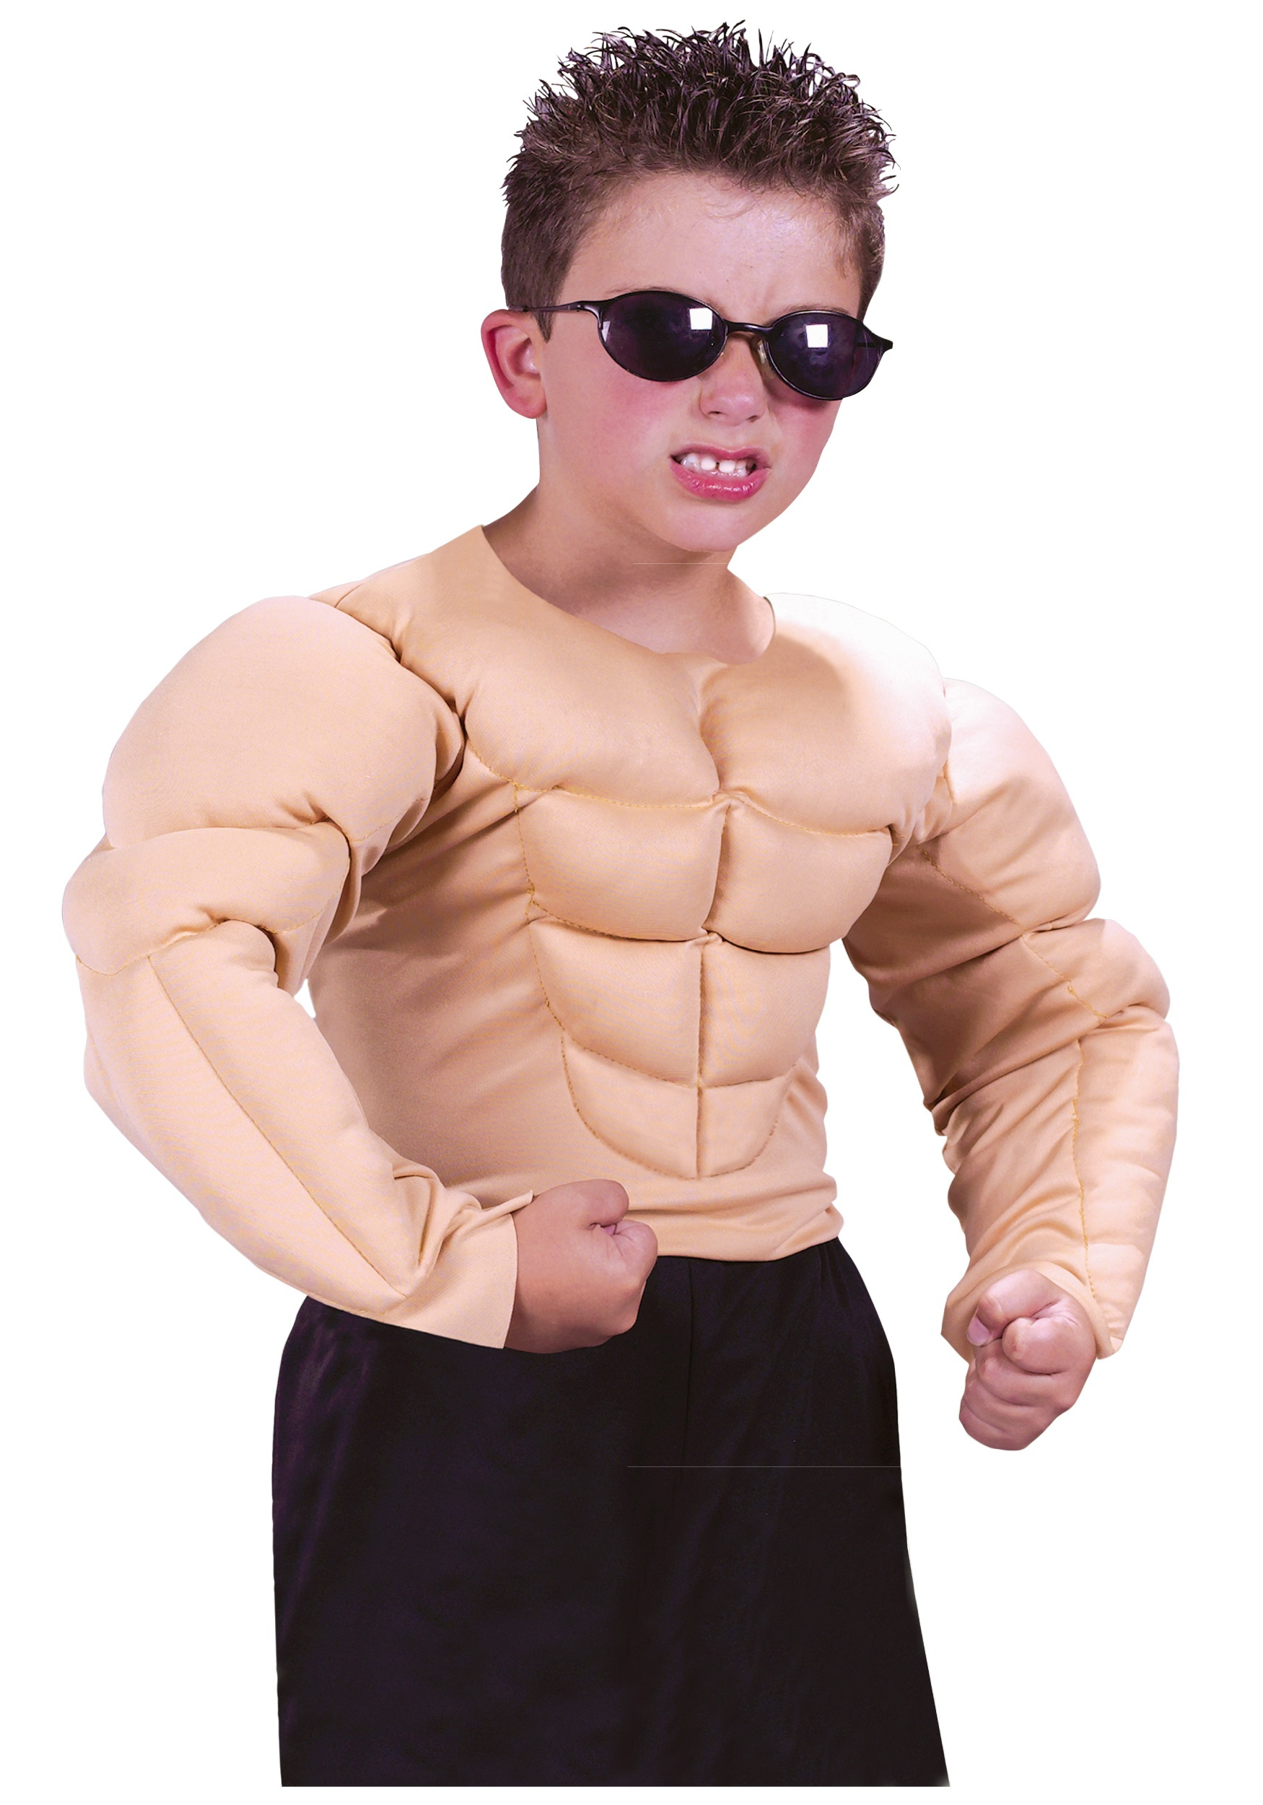
Today’s Learning Goals
In this lesson you will:
  Be able to identify different types of muscles
  Understand how different muscles in your body work
  Describe the functions of the skin

Slide 4
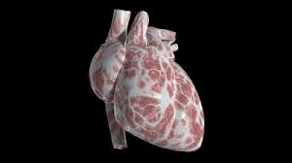
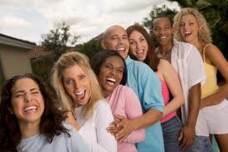
Muscles
Involuntary:
cardiac and smooth
Ex. Heart beat, digesting.
Voluntary: skeletal
Ex. Running, smiling.

Slide 5
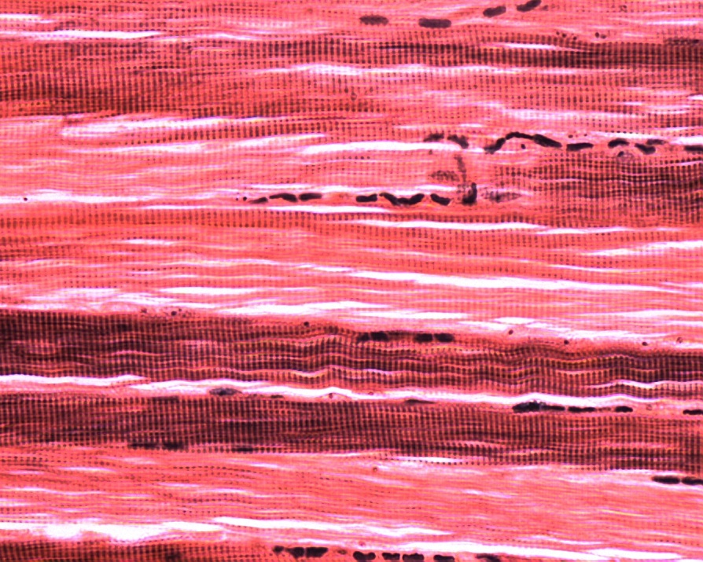
Types of Muscles
Skeletal: provides force that moves your body
Attached by connective tissue (tendon) to the bone
Draw a picture of me in your notes next to “Skeletal Muscle”!

Slide 6
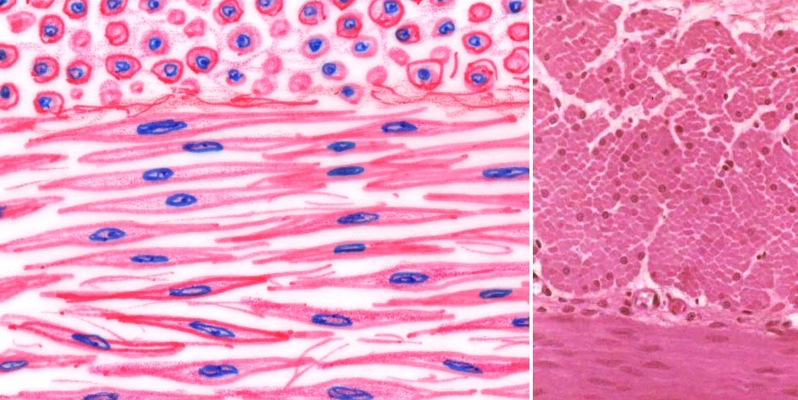
Types of Muscles
Smooth: inside internal organs and blood vessels
Controls movement inside the body
Draw me too!

Slide 7
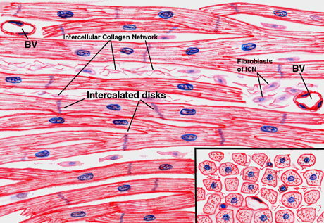
Types of Muscles
Cardiac: found only in the heart

Slide 8
Figure 1, page 171
Complete the Figure
You have 3 minutes
When you are done, you will take 1 minute (30 seconds for each partner) to share

Slide 9
While Paula watches TV, her dinner is digesting in her stomach. The muscles responsible for this are:
Involuntary
Voluntary
Tendons
Cardiac

Slide 10
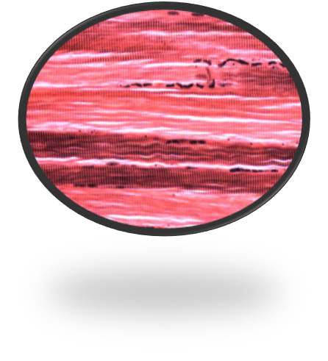
This type of muscle tissue appears banded and is attached to the bone by tendons.
Cardiac
Smooth
Skeletal
Involuntary

Slide 11
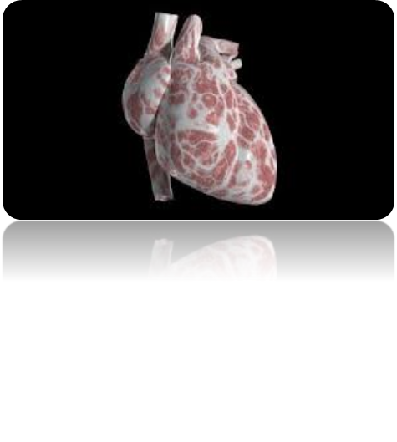
This muscle tissue can only be found in your heart.
Cardiac
Smooth
Skeletal
Involuntary

Slide 12
Goals Review
  Goal: Be able to identify different types of muscles
  Now we know that:
    Your body has skeletal, smooth and cardiac muscle tissue.
    Some of these muscle tissues are involuntary, meaning that their movements are out of your control.
    Some are voluntary, you can control these muscles.

Slide 13
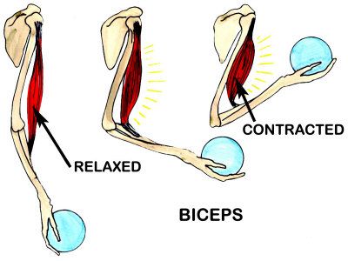
How Do Skeletal Muscles Work?
They work in pairs; when one muscle contracts (shorter and thicker), its partner muscle relaxes (longer and thinner)
One Muscle One Muscle
Relaxes Contracts

Slide 14
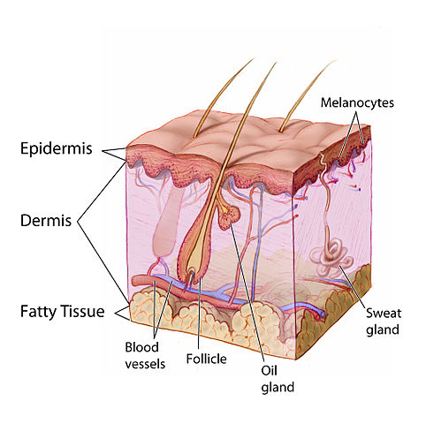
What are the Functions of the Skin?
Protection
Regulates Body Temperature
Eliminates Waste
Produces Vitamin D

Slide 15

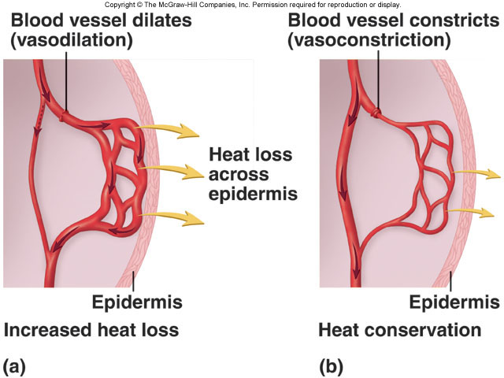
How does Skin Regulate Body Temperature?
Too Blood More Heat
Warm Vessels Blood Escapes
Enlarge Flows

Slide 16
Figure 2, page 178
Complete the Figure with your shoulder partner.
Discuss the functions demonstrated in each picture
Could there be multiple possible correct answers for any other these images?
You have 3 minutes

Slide 17
Which of these is NOT a function of skin?
Eliminates wastes
Produce vitamin D
Connects to bone
Regulate body temperature
Protects the body

Slide 18
When blood vessels in the skin dilate (enlarge), what is the skin trying to do?
Protect the body from outside threats
Regulate body temperature
Get rid of waste
Gather information
Produce vitamin D

Slide 19
Goals Review
  Describe the functions of the skin
    Now we know:
      The skin has two layers that help the body
        Protect the body
        Maintain body temperature
        Eliminate wastes
        Gather information about the environment
        Produce vitamin D

