Slide 1
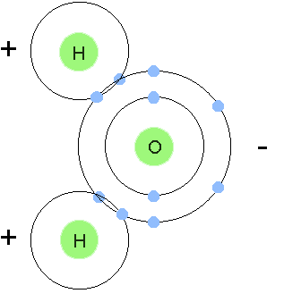
Molecules
1. Define Molecule (page 100)
2. What type of molecules can be found in your body?
3. How many elements is the model of water made up of?
4. Describe a molecule that all living things need.
5. How are elements and molecules related?
6. Cut out the picture of the molecule, glue it and color it on the molecules page.

