Slide 1
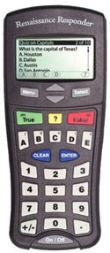
Happy Wednesday!
Today we will be learning about Forces!
Today’s Goal: Describe the differences between Contact and non-contact forces and Examples of each

Slide 2
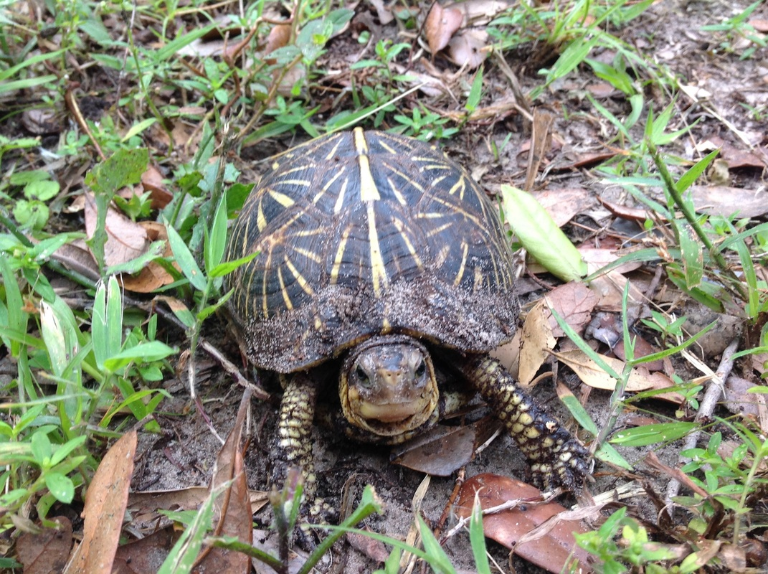
The Turtle’s Name is
Godzilla

Slide 3
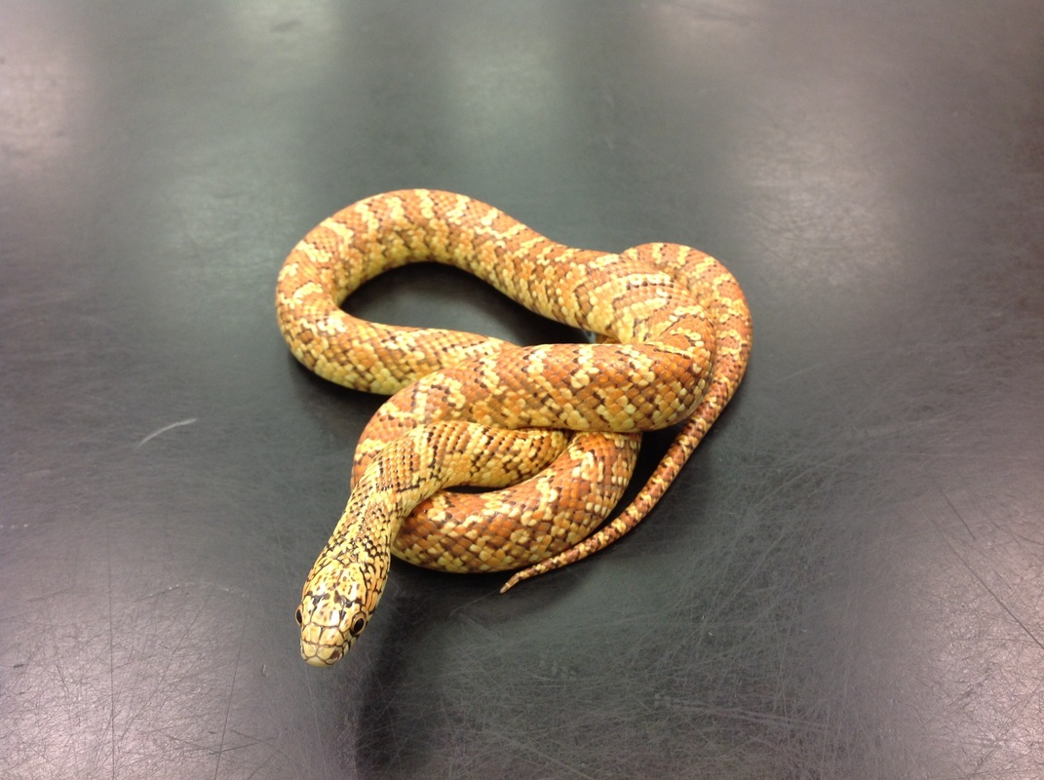
The Snake’s Name is
Autumn

Slide 4
What is a force?
A force is a push or pull
When one object pushes or pulls another object, the first object exerts a force on the second object
SI Unit: Newton (N)

Slide 5
Two Main Types of Forces
Contact forces
applied forces
normal force
friction
Non-contact/forces that act at a distance
Electrical
Magnetic
gravitational forces.

Slide 6
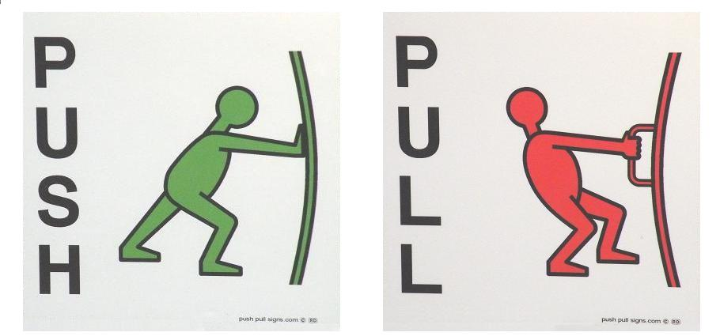
Applied Force
Applied force is a force that is put on an object by another object
Ex. Pushing open a door is an applied force because, by pushing the door, you are applying force to the door, causing it to move

Slide 7
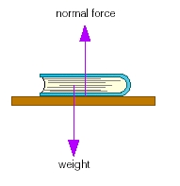
Normal Force
The normal force is the force that acts between objects when they are in contact with each other.
Normal = perpendicular
Examples:
When you lean on a wall, and it “pushes” back
When Earth “pushes” up at your feet when you are standing
or sitting

Slide 8
Friction
Friction is the force that two surfaces exert on each other when they rub against each other in opposite directions.
Smooth surfaces produce less friction than rough surfaces. Also, when the forces are heavier, there is more friction.
Examples:
your fingers rubbing against each other
A car driving down an icy road
Your pencil writing on a piece of paper

Slide 9
Which person is experiencing more friction? A or B?
B: because grass is a rougher surface than snow/ice and because the weight is less on skies because it is being distributed.

Slide 10
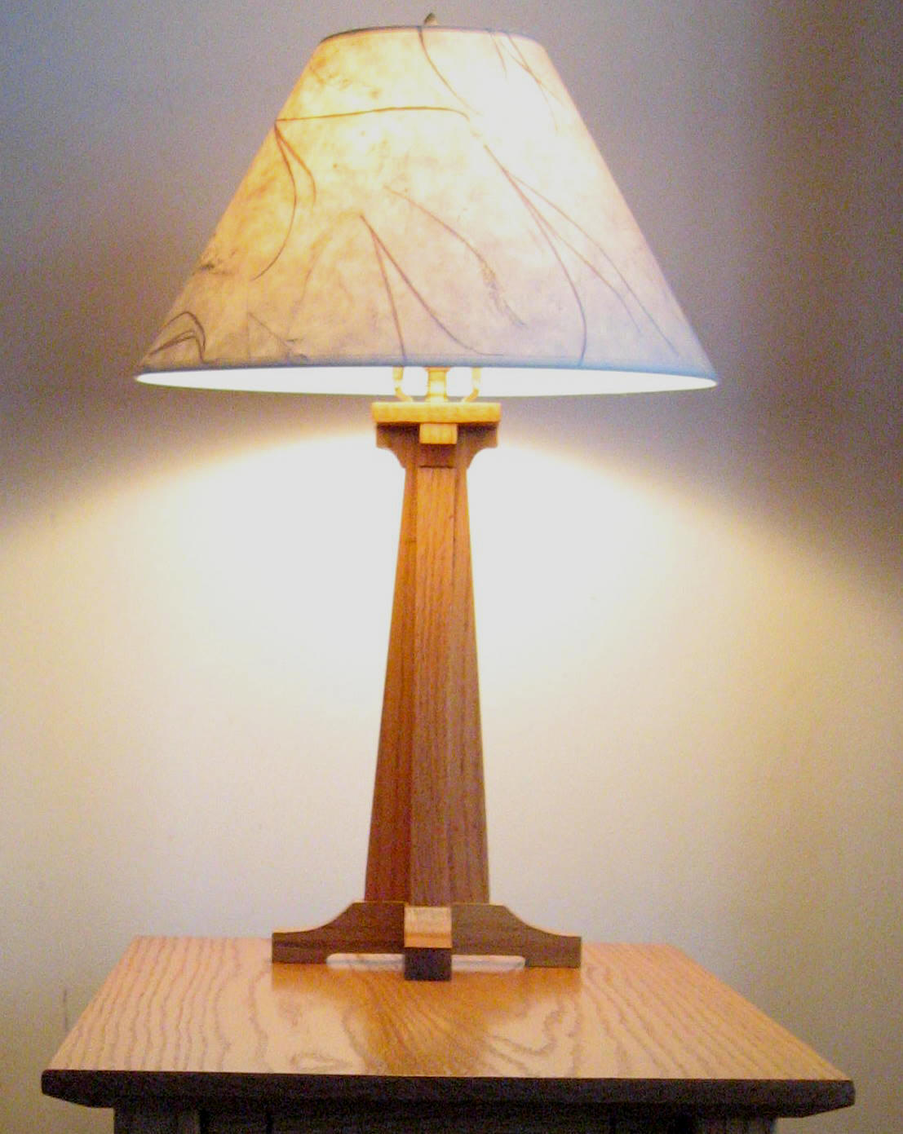
If a lamp is sitting on a table, what kind of force is the table exerting on the lamp?
Applied Force
Normal Force
Because the table is perpendicular to the lamp and the lamp’s gravity is pushing against the normal force of the table.
Friction

Slide 11
Non-Contact (forces that act at a distance)
These include types of forces that cause movement without actually touching another object.
They can exert force from a distance, not using physical proximity

Slide 12
Electrical Force
This is the force between two charged objects
Objects can have either positive or negative charges due to their electrons (negatively charged) and protons (positively charged). If two of the same charged objects come close together (but not necessarily touching) they will push each other away. If two oppositely charged particles move close together, they will attract one another

Slide 13
Complete Figure 3
Page 392

Slide 14
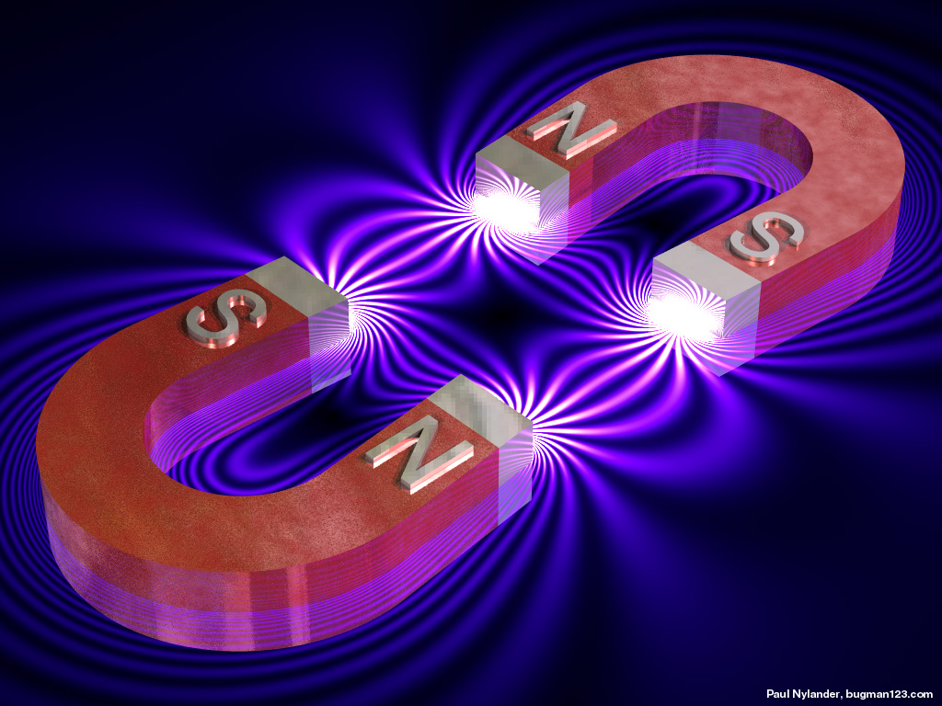
Magnetic Force
Magnetic force is similar to electrical force in the sense that two opposites will attract and two of the same will repulse.
Instead of charged particles, magnets use a north and south pole. If you move a north end and a south end close to each other, they are attracted together.

Slide 15
Gravitational Force
This force pulls objects towards each other
On Earth, all objects pull towards the center of the Earth (downwards). In space all objects pull towards other objects. Things with larger mass have a stronger pull.
The Law of Universal Gravitation: states that the force of gravity acts between all objects in the universe that have mass.

Slide 16
The Law of Universal Gravitation
The Law of Universal Gravitation: states that the force of gravity acts between all objects in the universe that have mass.
The two factors that affect the gravitational attraction between objects are mass and distance

Slide 17
What are types of contact forces?
Applied, gravitational and friction
Normal, Friction and Applied
Normal, electrical, and magnetic
Electrical, magnetic and gravitational

Slide 18
Friction always acts
In the same direction as motion
In the opposite direction of motion
Perpendicular to the direction of motion
At a 30 degree angle to the direction of motion

Slide 19
Class presentations
Get into groups based on the type of force on your card
You have 3 choices for the type of presentation you would like to do:
Powerpoint or Prezi with a demonstration
Skit demonstrating the force, must include all group members
Poster with explanation, must include illustration and must be explained using all group members.
Applied force
Normal force
Friction
Electrical
Magnetic
Gravitational

