Slide 1
Jeopardy
Q $100
Q $100
Q $100
Q $100
Q $100
Q $200
Q $200
Q $200
Q $200
Q $200
Q $300
Q $300
Q $300
Q $300
Q $300
Q $400
Q $400
Q $400
Q $400
Q $400
Q $500
Q $500
Q $500
Q $500
Q $500
Final Jeopardy

Slide 2
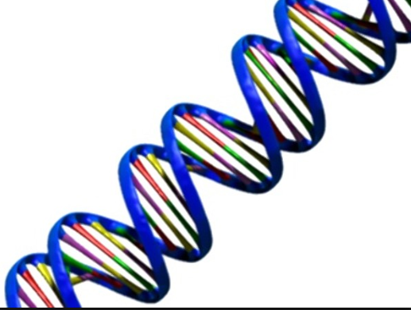
$100 answer* from H1
List what DNA stands for.

Slide 3
$100 Question from H1
Deoxyribonucleic acid

Slide 4
$200 answer* from H1
What does homozygous mean

Slide 5
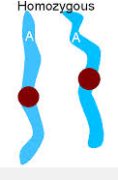
$200 Question from H1
Having two of the same or 2 alike alleles
For the trait

Slide 6
$300 answer* from H1
What is phenotype

Slide 7
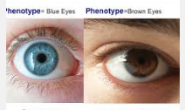
$300 Question from H1
An organism appearance written in words

Slide 8
$400 answer* from H1
What is a karyotype

Slide 9
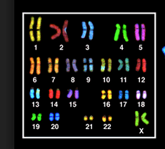
$400 Question from H1
A picture of the chromosomes in the cell arranged in pairs

Slide 10
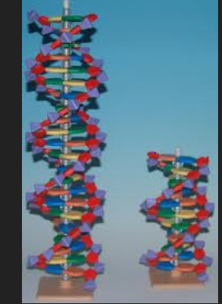
$500 answer* from H1
Name the 2 scientists that made the model of DNA

Slide 11
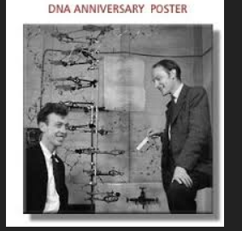
$500 Question from H1
Watson and Crick

Slide 12
$100 answer* from H2
In DNA adenine pairs with

Slide 13
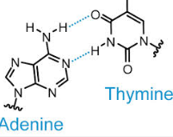
$100 Question from H2
thymine

Slide 14
$200 answer* from H2
In DNA cytosine pairs with

Slide 15
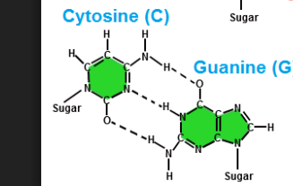
$200 Question from H2
Guanine

Slide 16
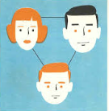
$300 answer* from H2
What is the passing of traits from parent to offspring

Slide 17
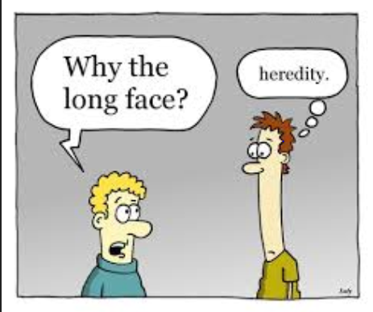
$300 Question from H2
heredity

Slide 18
$400 answer* from H2
Mitosis is what type of Reproduction and results in how many cells at the end?

Slide 19
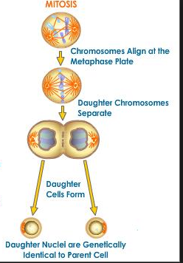
$400 Question from H2
Asexual reproduction and 1 cell results in 2 cells

Slide 20
$500 answer* from H2
What is an allele?

Slide 21
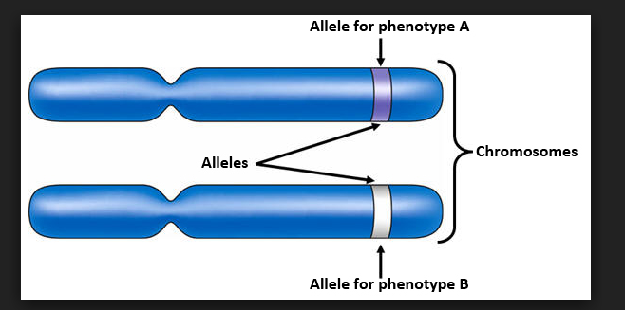
$500 Question from H2
A form of an gene

Slide 22
$100 answer* from H3
Write out an recessive genotype

Slide 23
$100 Question from H3
rr

Slide 24
$200 answer* from H3
List the 3 types of biotechnology

Slide 25
$200 Question from H3
Cloning, genetic engineering and artificial selection

Slide 26
$300 answer* from H3
What process produces gamete cells known as eggs and sperm

Slide 27
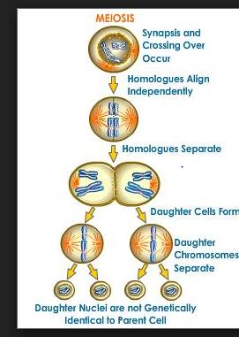
$300 Question from H3
meiosis

Slide 28
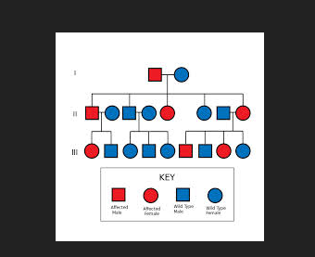
$400 answer* from H3
What is the reason to use a pedigree

Slide 29
$400 Question from H3
To Trace the inheritance of traits in human

Slide 30
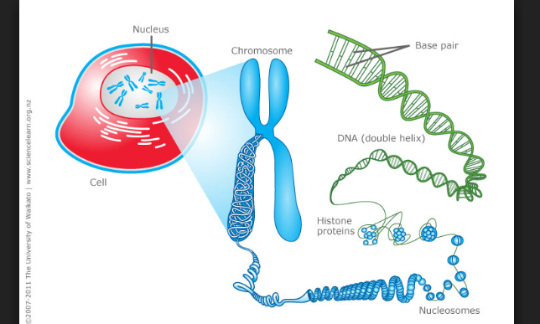
$500 answer* from H3
How many chromosomes in a human cell

Slide 31
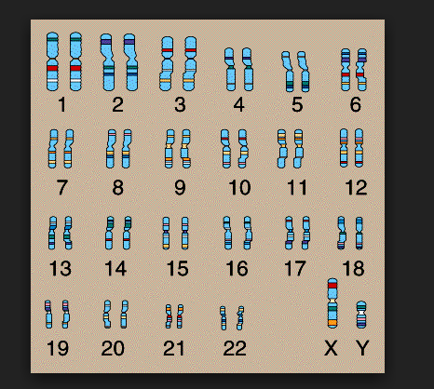
$500 Question from H3
46 chromosomes which is also 23 pairs

Slide 32
$100 answer* from H4
What is the study of heredity

Slide 33
$100 Question from H4
genetics

Slide 34
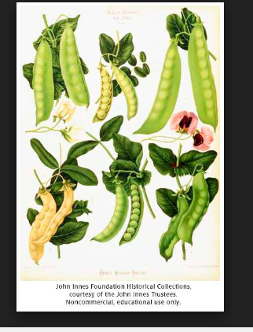
$200 answer* from H4
Name the scientist who cross pollinated plants in the study of genetics

Slide 35
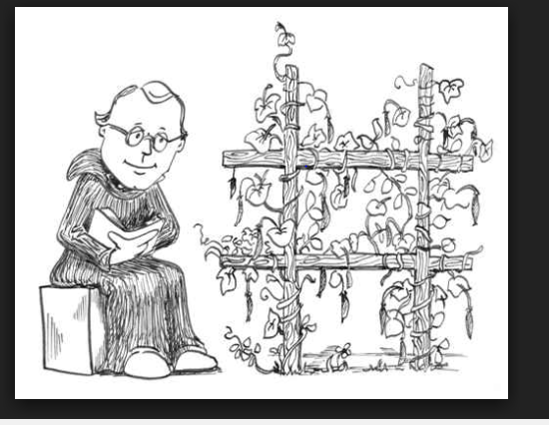
$200 Question from H4
Gregor Mendel father of genetics

Slide 36
$400 answer* from H4
Human sex cells eggs or sperm have how many chromosomes

Slide 37
$400 Question from H4
23 which is ½ the normal amount of regular chromosomes

Slide 38
$500 answer* from H4
Chromosomes are paired in the human cells so the 46 chromosomes become how many pairs

Slide 39
$500 Question from H4
23 pairs of chromosomes

Slide 40
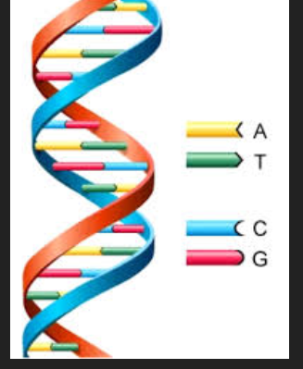
$100 answer* from H5
During DNA replication the strand produced is ___________ to the original strand

Slide 41
$100 Question from H5
Identical to the original

Slide 42
$200 answer* from H5
What does heterozygous mean

Slide 43
$200 Question from H5
Having 2 different alleles

Slide 44
$300 answer* from H5
List a purebred genotype

Slide 45
$300 Question from H5
FF which is also called homozygous

Slide 46
$400 answer* from H5
List a genotype with both alleles dominant

Slide 47
$400 Question from H5
FF

Slide 48
$500 answer* from H5
Definition of dominant allele

Slide 49
$500 Question from H5
Dominant alleles are a type of gene that masks the expression of a recessive allele

Slide 50
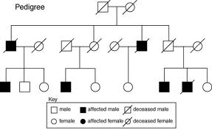
What genotype is generation I parents if the trait for a disease is recessive “a”

Slide 51
Both Aa parents offspring show recessive and dominant in the pedigree They could not have a recessive child unless both heterozygous if even one parent was AA all the children would be heterozygous

Slide 52
Draw a pedigree for the following father has trait of dimples mom does not have dimples they have 3 children 1 boy with dimples and 2 daughters without dimples

Slide 53
What is a hybrid also called heterozygous

Slide 54
An organism having 2 different alleles for a trait from a parent

Slide 55
Final Jeopardy
Make a punnett square for dad brown eyes B b
And mom blue eyes bb
List genotypes and percentages for each genotype

Slide 56
Final Jeopardy Answer
B b
b
b
Bb | bb
Bb | bb
50% bb 50% Bb

