Slide 1
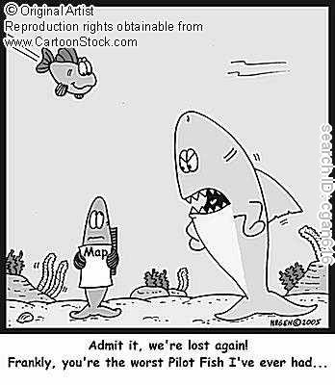
Interactions Among Living Things

Slide 2
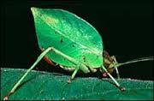
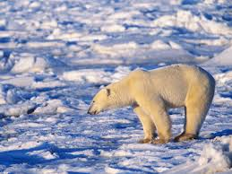
Adaptation
Every organism has a variety of adaptations that are suited to its specific living conditions and help it survive.

Slide 3
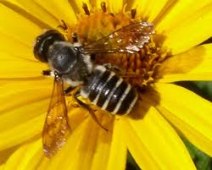
Niche
What is a niche? The job or role of an organism in the environment.
Ex. The bee’s job is to collect nectar. By doing this it pollinates flowers.

Slide 4
How do organisms interact with one another?
Competition-struggle between organisms to survive as they try to use the same resources.
Ex. Food and water

Slide 5
2. Predation-one organism kills another for food or nutrients.

Slide 6
3. Symbiosis- relationship between 2 species where at least one of the species benefits.

Slide 7
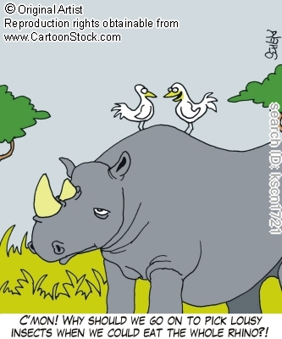
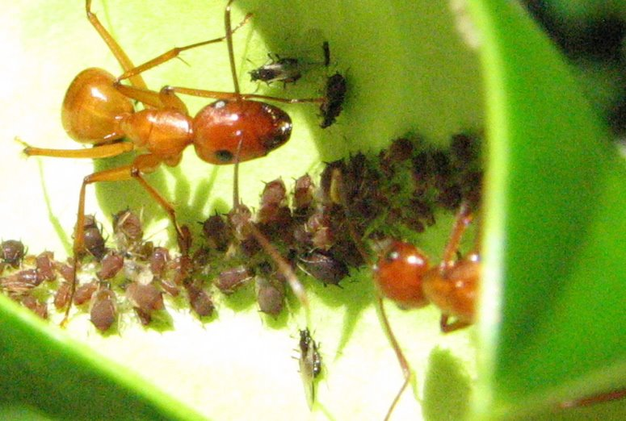
Types of Symbiosis
1. Mutualism-both species benefit.

Slide 8
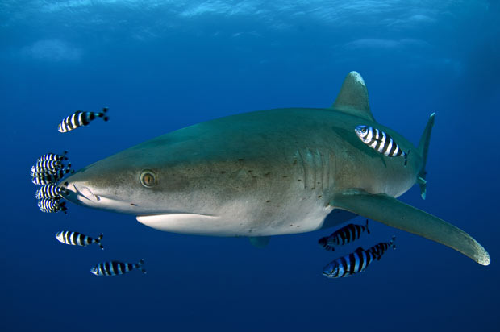
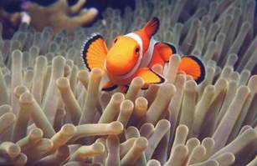
2. Commensalism- One species benefits and the other not harmed nor helped

Slide 9
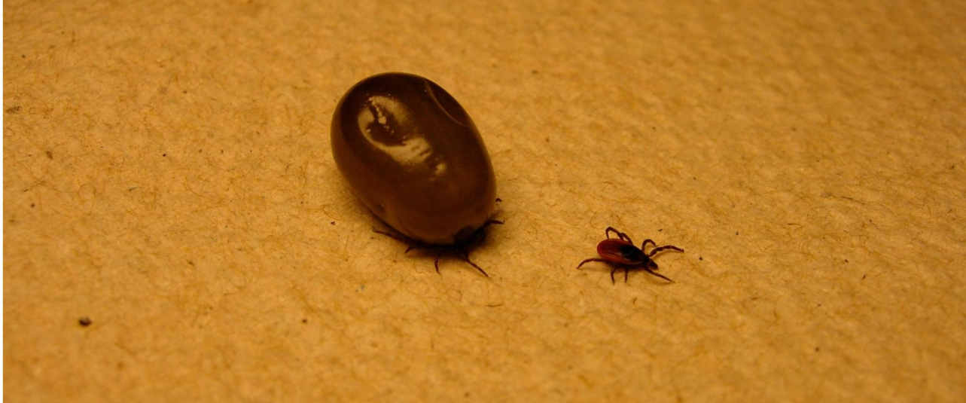
3. Parasitism- one benefits by living in or on another organism and harms it.

Slide 10
Stop Here

Slide 11
Please take out your 13.1 and 13.2 lessons for Ms. Keene to check.
Take out your notes!
Take out your sheet from yesterday!

Slide 12
What factors limit population growth?
Limiting factor-anything that restricts the number of individuals in a population
Examples- human interaction, space, food and water, environment, predation, diseases, nesting sites, parasitism

Slide 13
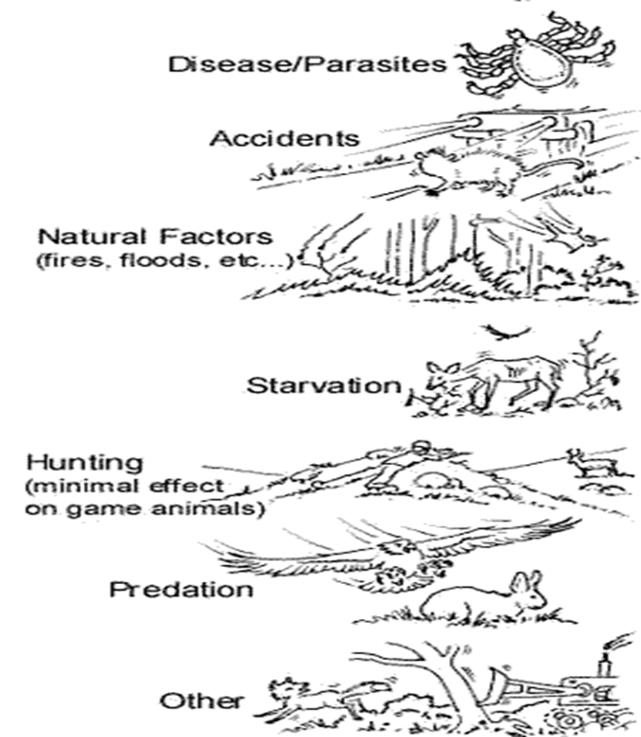

Slide 14
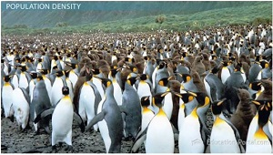
What is population density?
Number of individuals in a specific size of area.

Slide 15
Compare and contrast immigration and emigration
Emigration
Immigration
Moving out of a population
Change size of a population
Moving into a population

