Slide 1
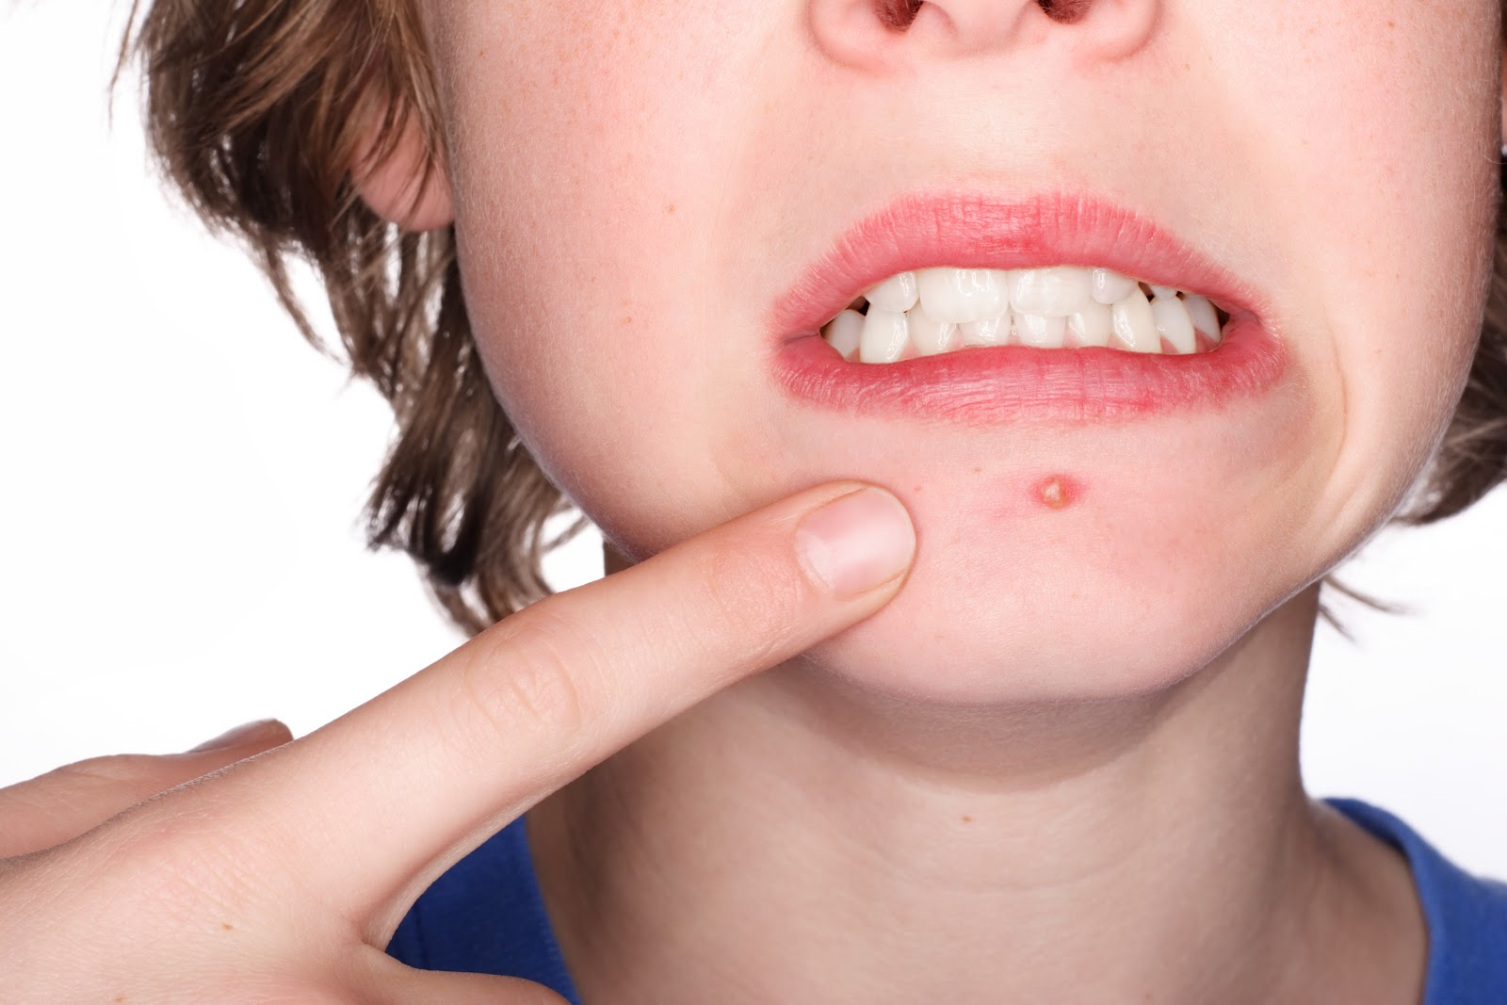
Happy Monday!
Bellwork:
Find your new seat!
Ask your new shoulder partner what they think causes acne. Write their hypothesis in your notes.
Now, read page 244 and complete the My Planet Diary on that page.

Slide 2
What causes diseases?
Ancient Times
Evil spirits
Foul-smelling air
Imbalance of body fluids
1860’s
Louis Pasteur
Microorganisms caused diseases experiment with silk worms
1880’s
Joseph Lister
Microorganisms caused diseases that followed surgeries
Specific organisms cause each disease
organisms that cause disease are pathogens

Slide 3
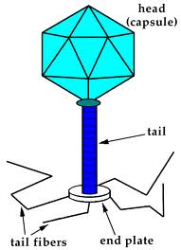
Viruses
Reproduce in cells
Non-living
Much smaller than bacteria
Example: Flu, cold, HIV

Slide 4
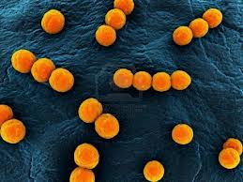
Bacteria
Unicellular
Damage cells with toxins
Example: Strep-throat, tetanus, ear infection

Slide 5
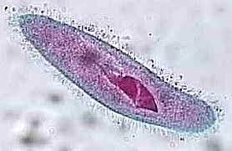
Protists
Unicellular
Larger than a bacterium
Causes diseases common in tropical areas
Example: malaria

Slide 6
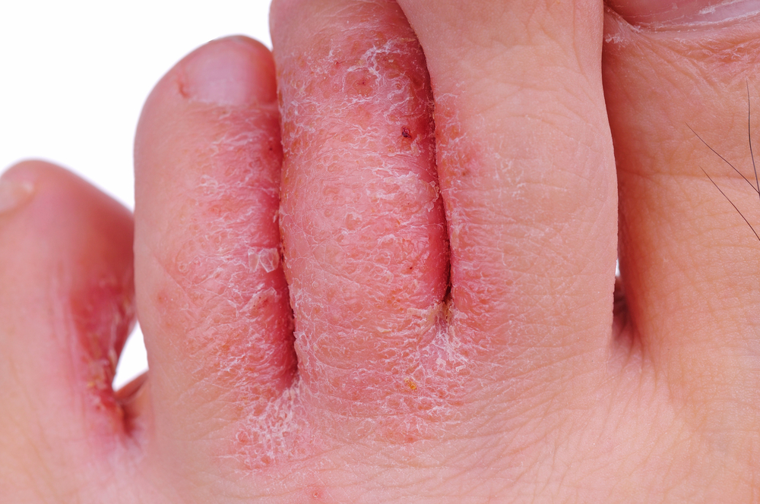
Fungi
Uni- or multi-cellular
Grow in warm, dark areas
Example: athletes foot, ring worm

Slide 7
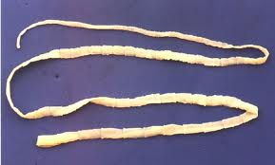
Parasites
Uni- or multi cellular
Live in or on host and cause it harm
Example: Tape worm, tick

Slide 8
Bacteria harm your body by:
Living on or inside you and causing harm
Damaging cells with toxins
Reproducing inside healthy cells
Bacteria does not harm your body

Slide 9
This type of pathogen is not actually living
Virus
Bacteria
Protist
Fungi
Parasite

Slide 10
Fungi grows in:
Cool, well-lit environments
Cool, dark environments
Warm well-lit environments
Warm, dark environments

Slide 11
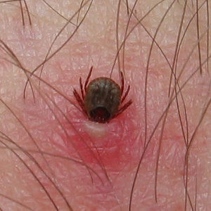
A tick is an animal that attaches to a host and feeds off the hosts blood, this harms the host.
What is this?
Virus
Bacteria
Protist
Fungi
Parasite

Slide 12
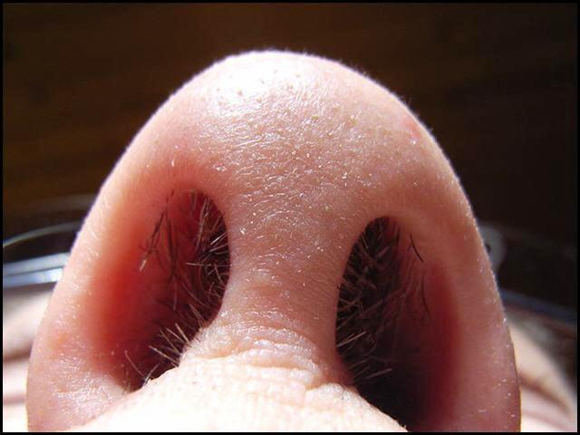
First Line of Defense
Surface of your Skin
Breathing passages
Mouth and stomach act as barriers which trap and kill most pathogens

Slide 13
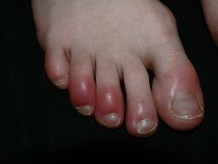
2nd Line of Defense
Inflammatory Response
Fluid and White blood cells come from blood vessels and fight against pathogens.

Slide 15
3rd Line of Defense
Immune response
Immune cells in the blood and tissue react to each kind of pathogen

Slide 16
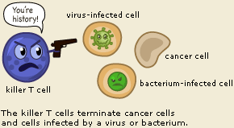
Immune System

Slide 17
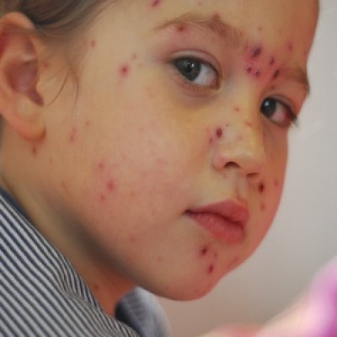
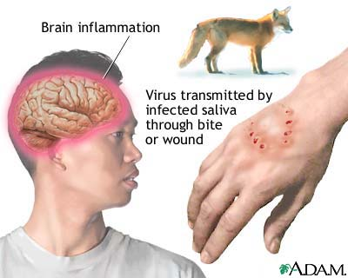
Types of Immunity
Active-your bodies immune system produces antibodies
Chicken pox
Vaccine-weakened form of the virus
Passive -antibodies come from another source
Rabies
Antibodies given to a person

Slide 18
Infectious vs. noninfectious
Infectious
Virus, bacteria, protist, fungi, parasites, etc
Noninfectious
Not caused by pathogens
Inherited from parents or environment
Allergies, asthma, diabetes, cancer

Slide 19
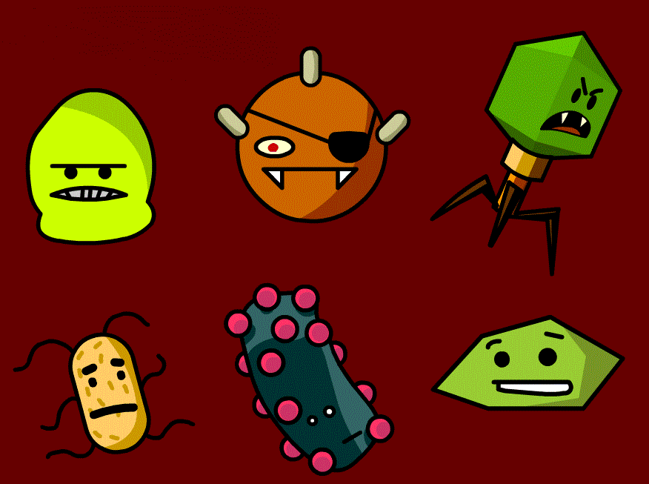
Brainpop!
https://www.brainpop.com/health/bodysystems/immunesystem/

