Slide 1
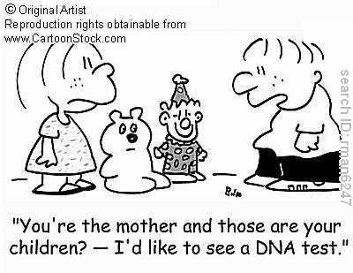
Heredity

Slide 2
Unit Goal
Students will investigate the concept of heredity and species diversity in terms of cellular reproduction, DNA, traits and the impact of biotechnology

Slide 3
Today’s specific Learning Goal
Determine the probabilities for genotype and phenotype combinations using Punnett Squares and pedigrees

Slide 4
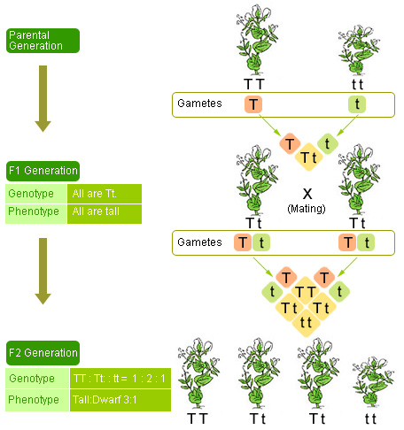
What is Genetics?
Genetics-The study of heredity

Slide 5
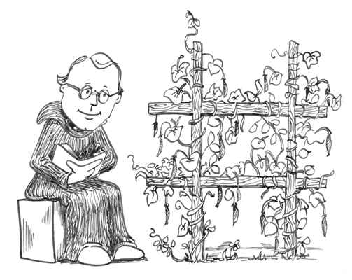
Genetics
Heredity is the passing of physical and behavioral traits from parents to offspring
Gregor Mendel-Father of Genetics

Slide 6
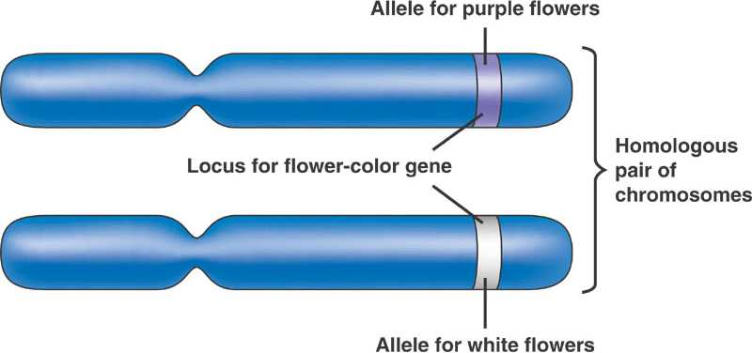
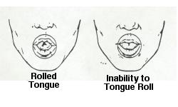
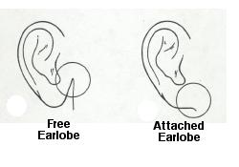
Alleles
~Different forms of a gene
~one allele from mom, and one from dad
Ex: T- Tall, t-short
B-Brown, b-blue

Slide 7
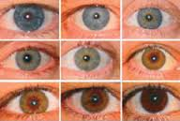
Dominant vs. Recessive
Alleles can be:
Dominant- trait that shows up in the organism (Capital letters. Ex: B, Bb)
Recessive- is hidden if there is a dominant gene, but shows if there isn’t. (lowercase letters. Ex: b, bb

Slide 8
Genotypes
Genotypes -genetic make-up of the organism
AA
Aa
aa

Slide 9
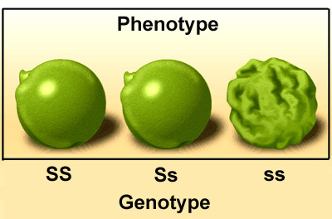
Phenotype
Physical appearance of an organism
SS,Ss,ss. Ex. Pea texture

Slide 10
Compare and Contrast Phenotype and Genotype.

Slide 11
Which of the following is a genotype?
A
aa
B
b

Slide 12
Which of the following is a phenotype?
Blue eyes
Aa
A
Dominant

Slide 13
Which letter represents the dominant gene?
a
A

Slide 14
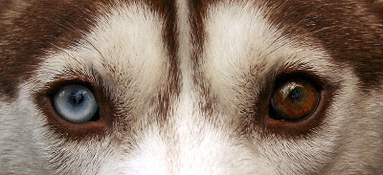
Which Trait will be represented with the letter combination of Bb?
B-Brown Eyes
b-Blue eyes

Slide 15
Goal Review
Determine the probabilities for genotype and phenotype combinations using Punnett Squares and pedigrees
Now we know:
That genotype is the genetic makeup of an organism, and is represented using letters that come in pairs. EX. Bb
That phenotype is the physical trait that we can see in the organism. EX. curly hair

Slide 16
Genetics with a Smile
Flip for traits
Heads = dominant, tails = recessive
Each partner flips their coin
Circle the trait (uppercase or lowercase) from both mom and dad
Write the 2 letter genotype
Write the phenotype- find this by using the “Smiley Face Traits” sheet
Let’s try the first one together!

Slide 17
Wrap Up
After today’s notes and activity, how well do you think you understand genotype and phenotype, and dominant and recessive traits?
4. I totally get this! I could teach it to a friend.
3. I get it! Just to make sure, I would ask a friend
2. I get some of it…but some other parts are a little unclear
1. I don’t really get it. I still need some help.

Slide 18
Clicker Return
Please pass your Clickers to the Resource Manager at your group
Resource Manager, please return the Clickers to the Clicker Caddy. Make sure they are in the correct slot
Everyone else, please pack up.

Slide 19
Part 2- Heredity

Slide 20
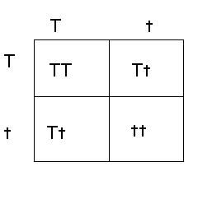
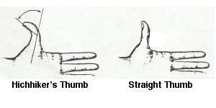
Punnett Squares
If T= straight hair and t = curly hair, what is the probability that the offspring will have straight hair?
Chart that shows all the possible ways alleles can combine in a genetic cross
Based on probability

Slide 21
Purebred vs. Hybrid
RR
Purebred or homozygous-same form of the trait from each parent
Hybrid or heterozygous-two different forms of the trait, one from each parent
Rr
rr

Slide 22
Tongue rolling (T) is dominant over non tongue rolling (t). A homozygous Tongue rolling male X a heterozygous female.
T
t
T
TT
Tt
T
TT
Tt
What percentage of the time would these parents have a child with the ability to roll their tongues?
100% Tongue rollers. All offspring have a dominant T for tongue rolling.

Slide 23
Dimples (D) are dominant over non-dimples (d). A heterozygous (hybrid)
Male x a nondimpled female.
d
d
Dd
Dd
D
d
dd
dd
50% dimples, 50% non-dimples

