Slide 1
Bellwork: Complete the “My Planet Diary” on page 216. When you are done, discuss your answers with your shoulder partner

Slide 2
The Excretory System
The excretory system collects the wastes that cells produce and removes them from the body
The body must excrete excess water and urea, a chemical that comes from the breakdown of proteins.

Slide 3
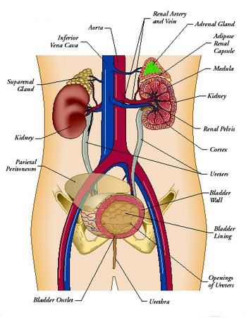
Organs in the excretory system are:
Kidneys
Ureters
Urinary bladder
Urethra
Lungs
Skin
liver

Slide 4
Do the Math!
Complete page 217, “DO the Math!” Section with your partner
This includes the challenge question

Slide 5
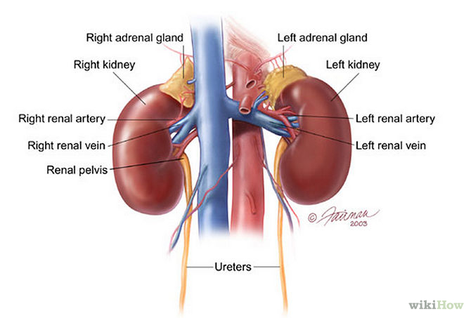
Kidneys
The major organs of the excretory system
They are like filters, removing urea and other wastes from your blood
These wastes are taken out of your body in your urine

Slide 6
Nephrons
Each Kidney has around 1 million nephrons; tiny filtering structures that remove waste from the blood and produce urine
Nephrons do 2 main things:
Filter out both wastes and needed materials from the blood
Wastes are eliminated (in the form of urine) and needed materials are returned to the blood

Slide 7
Figure 2
Complete figure 2 on page 219, be ready to share your answers
You have 3 minutes
Red: oxygen-rich blood from the aorta
Blue: oxygen-poor blood from the vena cava
Yellow: The nephron Tube
It is important for capillaries to surround the nephron tube because needed materials pass back into the blood through the capillaries

Slide 8
How does excretion help Homeostasis?
Excretion helps to maintain homeostasis by keeping the body’s internal environment stable and free of harmful levels of chemicals
Lungs: remove water and some carbon dioxide when you exhale
Skin: contains sweat glands that excrete water, salt and a small amount of urea
Liver: produces urea from the breakdown of proteins
Complete “Identify the main idea” on page 221

Slide 9
Moving things along
Use the reminder of the class period to complete the activities on pages 222-223.
If you don’t know and answer, Look it up!

