Slide 1
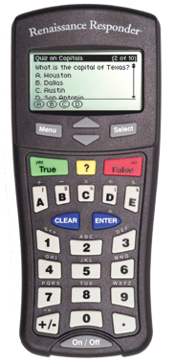
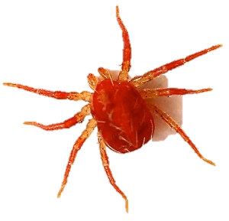
Happy Friday!!! (you made it!)
Bellwork:
Complete Figure 5 on page 332. Read the paragraph at the top to understand the difference between a field guide and a taxonomic key (dichotomous key).
When you are done, use the
same key to identify the creatures
on page 333.

Slide 2
Notes: Domains and Kingdoms
Take out your notebooks and continue your Lesson 2 notes with this title.
Remember, you can use doodle notes at any time while you are taking notes.

Slide 3
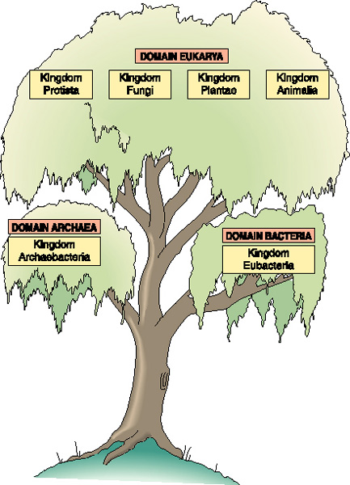
Domains and Kingdoms

Slide 4
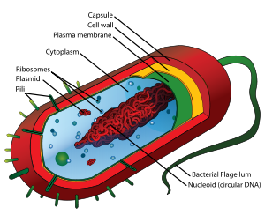
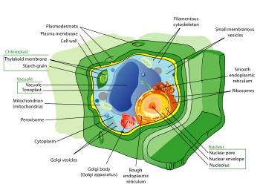
How are organisms classified?
1. By cell Type
Prokaryotic-lack a nucleus
ex. Bacteria
Eukaryotic-Has a nucleus
ex. Plant and animal cells

Slide 5
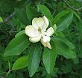
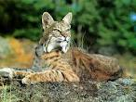
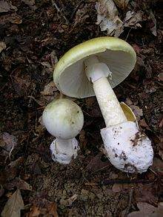
How are organisms classified?
2. Ability to make food
Autotrophs-make their own food
Ex. Plants, some protists, and bacteria
b. Heterotrophs-cannot make their own food
Ex. Animals and fungi

Slide 6
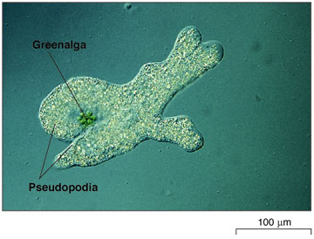
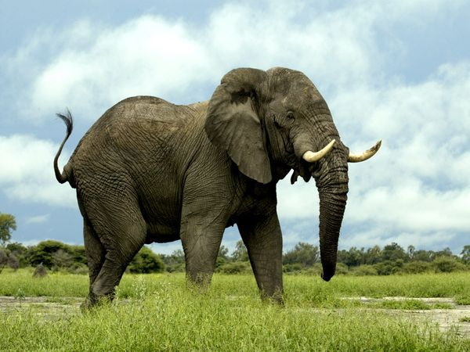
How are organisms classified?
3. Cell number
Unicellular
Ex. Bacteria, archaea, most protists
b. Multicellular
Ex. Plants, animals and some protists

Slide 7
True or False
Prokaryotic cells have a nucleus.

Slide 8
True or False
Heterotrophs can make their own food.

Slide 9
Multiple Choice
All of the following are ways organisms are classified except:
Cell type
How they move
Cell number
Ability to make food

Slide 10
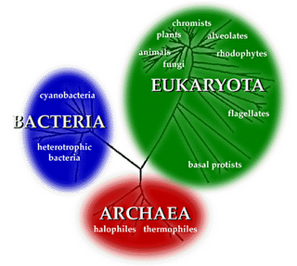
Three domains of Life

Slide 11
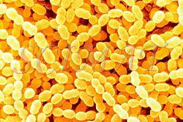
Three domains of Life
1. Bacteria
Prokaryotic
Autotropic and Heterotropic
Found Everywhere
Unicellular

Slide 12
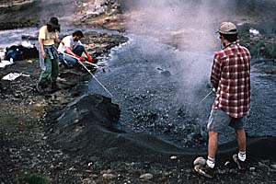
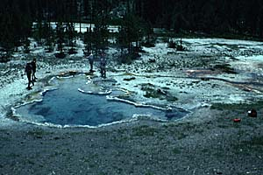
Three domains of Life
2. Archaea
Prokaryotic
Autotropic and heterotropic
Chemical makeup is different from bacteria
Found in extreme environments

Slide 13
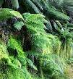
Three domains of Life
3. Eukarya
Eukaryotic
Protistis-uni and multi-cellular; autotropic and heterotropic
Fungi-multicullular and heterotropic
Plants-mulitcellular and autotropic
Animals-muliticellular and heterotropic

Slide 14
True or False
Domain Eukarya contains unicellular and multicellular organisms.

Slide 15
True or False
Bacteria can be found in your gut.

Slide 16
Multiple Choice
Which of the following is TRUE about Archaea?
Have a nucleus
Only autotrophic
Same chemical makeup as bacteria
Found in extreme environments

Slide 17
Rate Yourself
How well do you feel you understand this information?
1
2
3
4

