Slide 1
Bellwork
Begin a new page in your notebook. Title it “DNA and Genetics”
Copy down the learning goal exactly as it is written in your scale (find it in the binder)

Slide 2
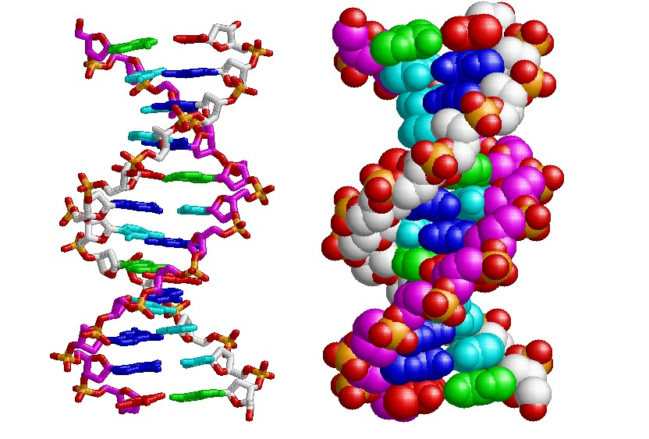
DNA

Slide 3
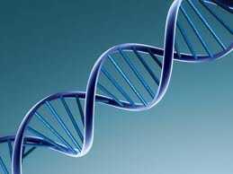
What is DNA?
Contains info for growth/function
DeoxyriboNucleic Acid
Stored in nucleus

Slide 4
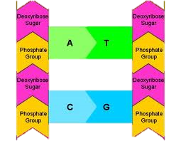
What is DNA made up of?
Sugar=deoxyribose
Phosphate
Nitrogen bases: Thymine, Adenine, Guinine, Cytosine
A=T
G=C

Slide 5
Determine the matching DNA strand
ATGCTAGGAT
GCATCGCCGC
TACGATCCTA
GCATATCCGC
TACGAGCCAT

Slide 6
DNA contains instructions for:
Breathing and Eating
Growth and Function
Growth and Reproduction
Thinking and Feeling

Slide 7
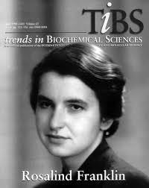
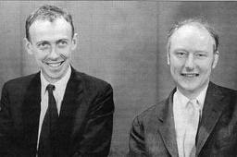
What does DNA look like?
1952 Rosalind Franklin discovered that DNA is 2 chains in spiral form
Double helix
1953 F. Crick & J. Watson made a model

Slide 8
https://www.youtube.com/watch?v=VegLVn_1oCE

Slide 9
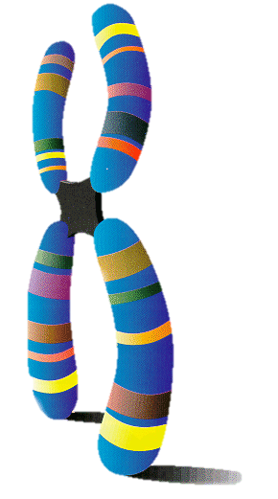
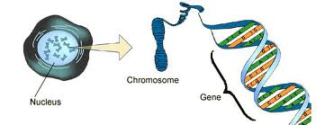
DNA
DNA stores info for making proteins in genes
A gene is a section of DNA on a chromosome
Found in the nucleus

Slide 10
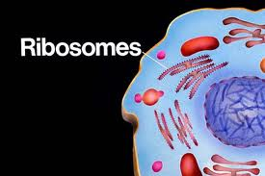
DNA
The codes for making proteins are carried to the ribosomes by RNA [made by DNA]

Slide 11
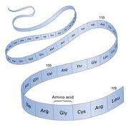
What are proteins?
Chains of thousands of amino acids (a.a.) genes determine the order of a.a.

Slide 12
Adenine always bonds with what base?
Thymine
Guanine
Cytosine
Adenine

Slide 13
Cytosine always bonds with what base?
A. Thymine
B. Guanine
C. Cytosine
D. Adenine

Slide 14
DNA has the structure of what?
a step ladder
twisted ladder
a ladder
a chair

Slide 15
Who was responsible for the discovery of DNA?
Franklin, Watson, and Crick
Perez, Keene and Francher
Franklin and Watson
Franklin and Crick

Slide 16
Exit Slip
On your scale tracking page, please rate your understanding of the content for this unit
Remember to refer back to your scale!

