Slide 1
Organs in the Digestive system
Bellwork:
Compare and contrast mechanical digestion and chemical digestion

Slide 2
The order
Mouth
Esophagus
Stomach
Small Intestine
Large Intestine
Rectum

Slide 3
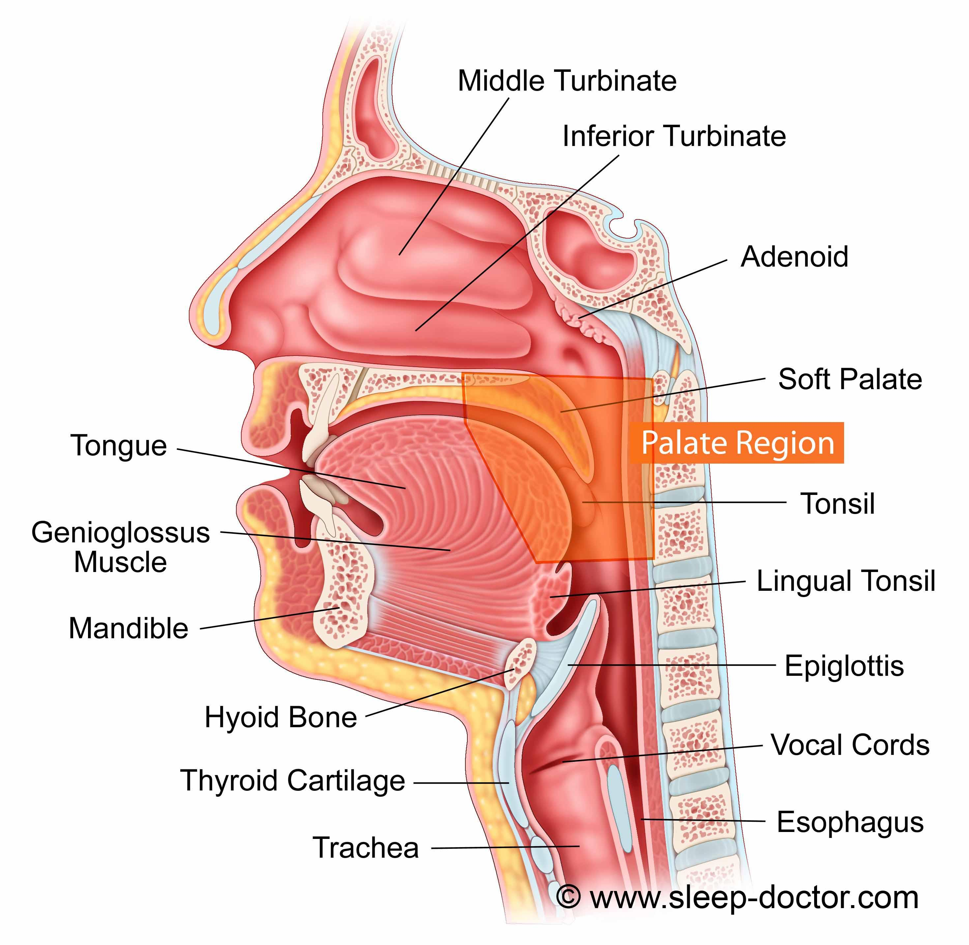
Mouth
Mechanical Digestion
Breaks up food with teeth
Chemical Digestion
Enzymes in saliva speed up the breaking down of starches

Slide 4
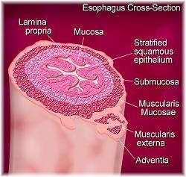
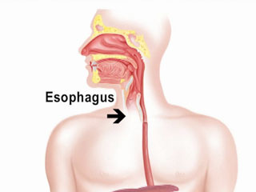
Esophagus
Lined with mucus to allow food to easily move to the stomach

Slide 5
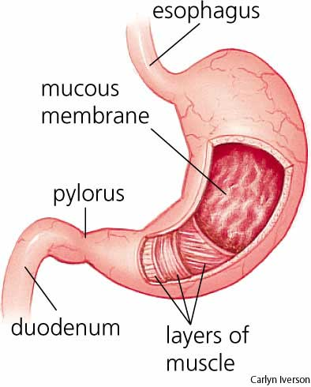
Stomach
Mechanical digestion
Smooth muscle contracts, producing a churning motion
Chemical Digestion
Food mixes with digestive juices
Pepsin digests proteins into amino acids

Slide 6
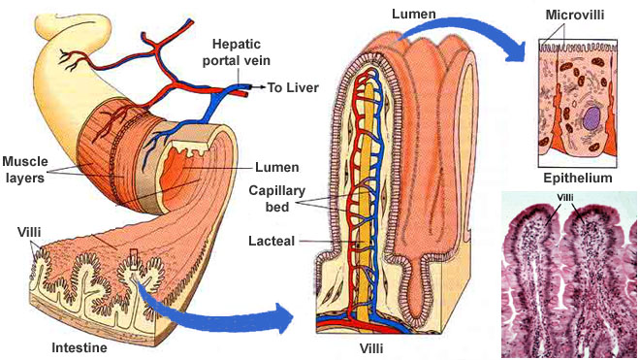
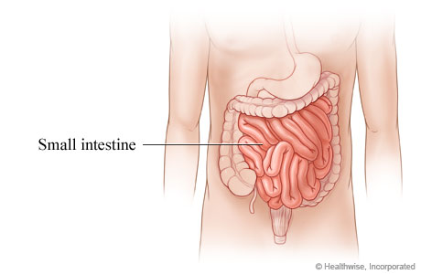
Small Intestine
Chemical Digestion
Fats are broken down from accessory organs: liver and pancreas
Absorption happens from villi, which take up nutrients

Slide 7
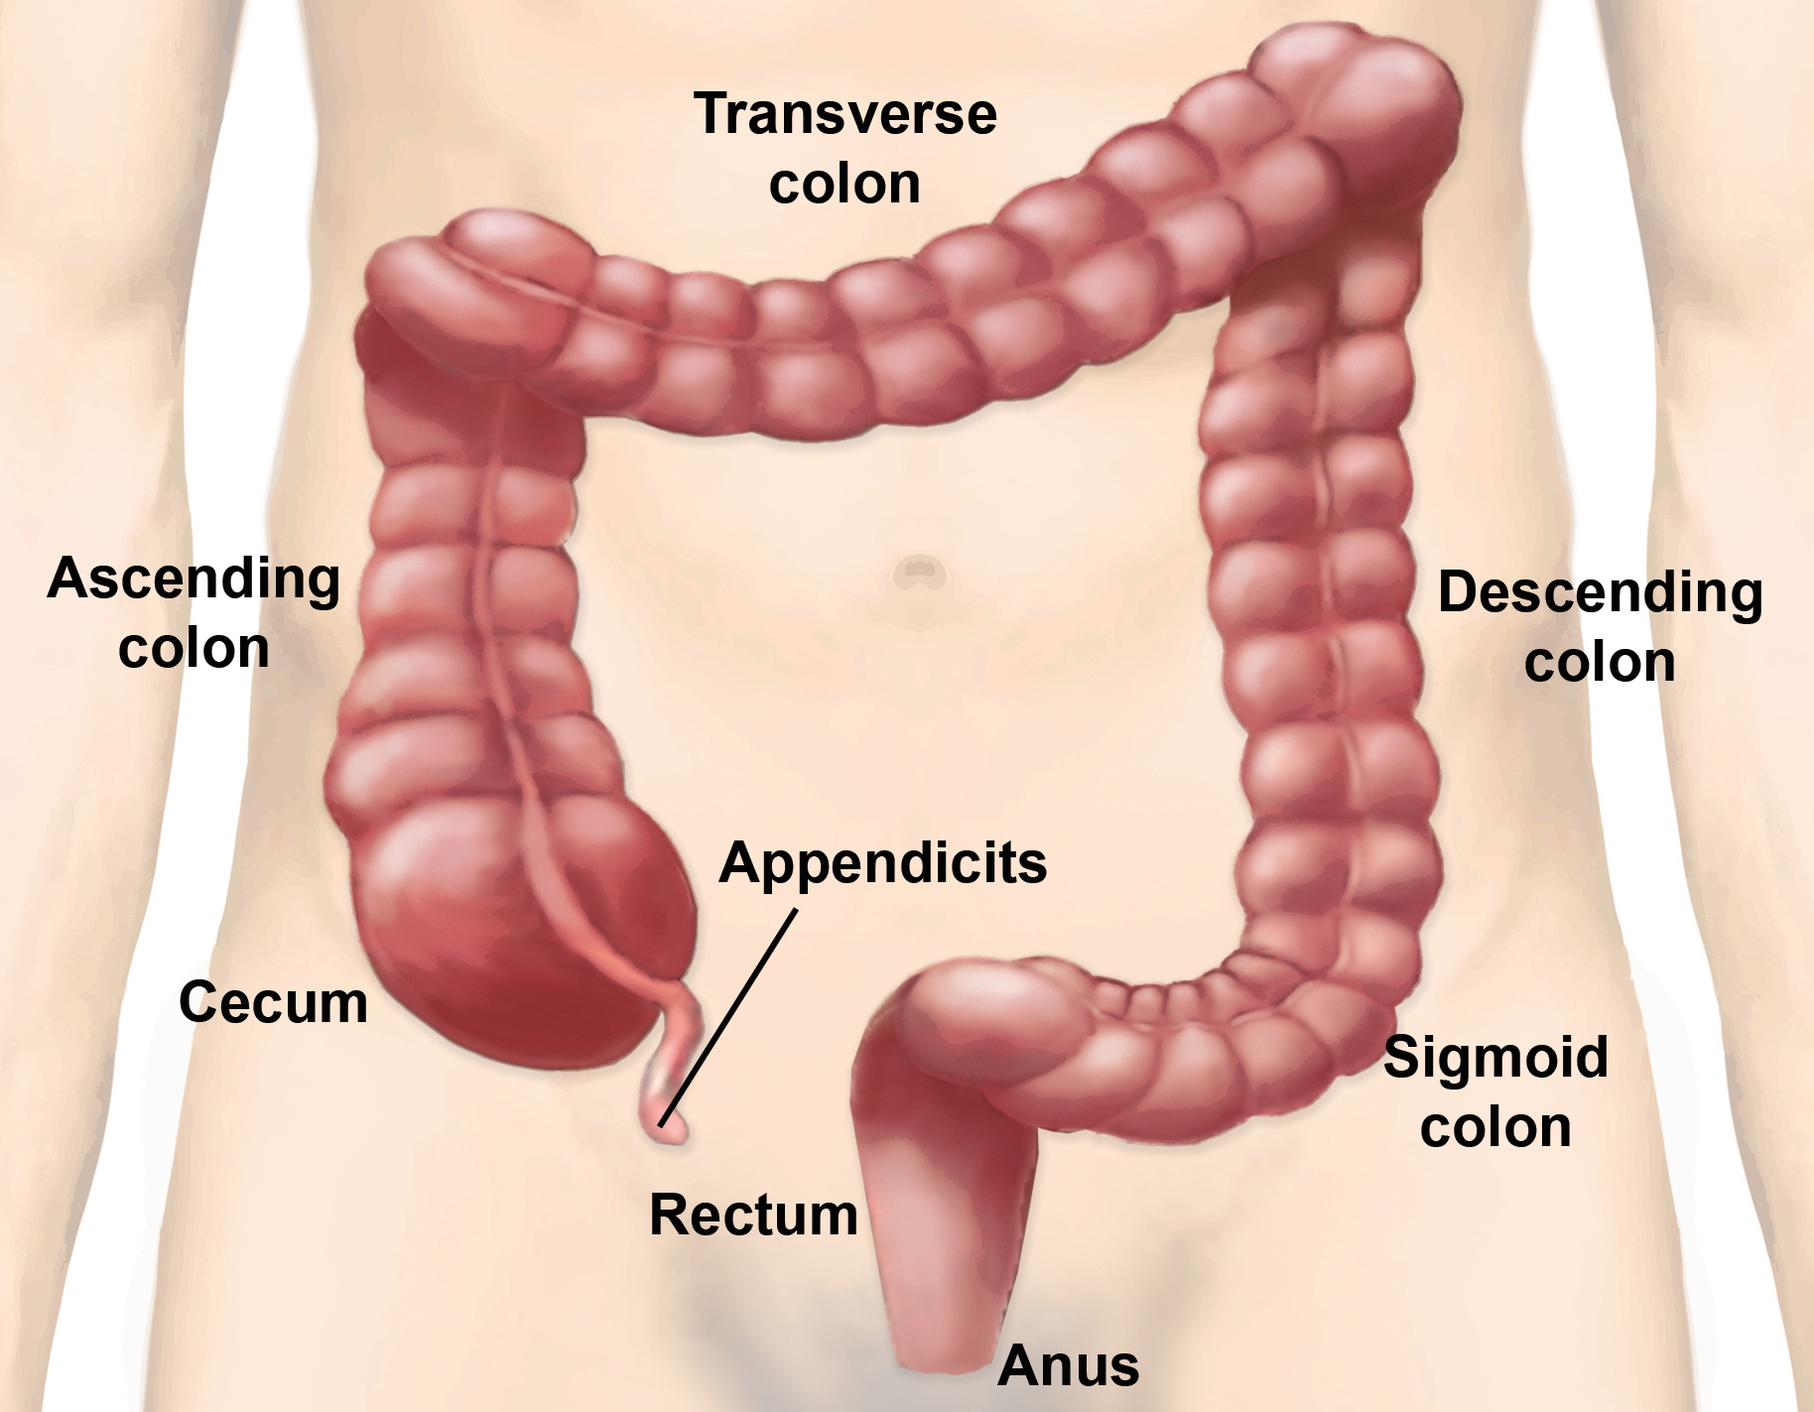
Large Intestine
Absorption
Water and undigested food enter.
Water is absorbed into the blood, the rest is prepared for elimination by bacteria

Slide 8
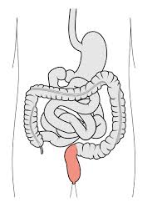
Rectum
Muscular Opening for Elimination

Slide 9
Accessory Organs
Pancreas: Gland that produces body juices
Liver: Large lobed organ that produces bile
Gall Bladder: Stores Bile

