Slide 1
Happy Monday!
Bellwork:
Turn to a new page in your notebook
Title this page: Change Over time
Write 7 words that you associate with the word “Evolution”

Slide 2
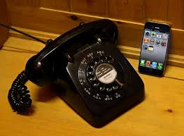
Change Over Time

Slide 3
What is evolution?
Scientific theory which explains how living things descended from earlier organisms

Slide 4
Evidence (You don’t need to copy this page)
There are many forms of evidence scientists use to contribute to the theory of evolution
We will discuss each of these. Get your page ready!
Fossils
DNA
Homologous structures
Vestigial Structures
Embryology

Slide 5
Fossils
Preserved remains or traces of organisms
Helps determine appearance and habits of living things

Slide 6
DNA
Mutations drive change
Helps confirm conclusions based on fossils, embryos, and body structures
Ex: dogs closely related to wolves

Slide 7
Homologous structures
Body parts with similar structures and sometimes functions.
Ex: bird wing, dolphin flipper, dog leg

Slide 8
Analogous vs. Homologous (you don’t need to copy this slide)
Analogous structures appear when unrelated species adapt to have similar shaped bodies
Homologous structures are when related species adapt to have different shapes while using the same basic design (all animals on left have 5 fingers)

Slide 10
Vestigial Structures
Structures without function
Ex. Snake pelvis and leg bones and whale pelvic bone

Slide 11
Embryology
Study of embryos and their development
Organisms all start similar and change from there. The more similar the embryos, the closer related the species.

Slide 12
Evidence
Fossils
Similarities in DNA and protein structures
Similar body structures
Pattern of early development

Slide 13
Clicker Questions
_______ are remains of life from an earlier time.
a.) sedimentary rocks
b.) fossils
c.) variations
d.) vestigial structures

Slide 14
Scientists can tell whether organisms are closely related by comparing their ____.
a.) hair color
b.) teeth
c.) DNA
d.) scientific names

Slide 15
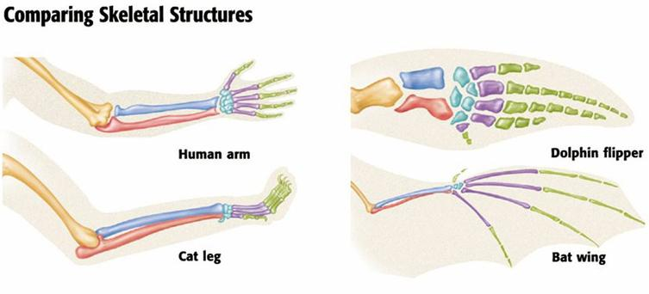
The fact that a these animals all have similar bone structures is what type of evidence for evolution?
a.) fossils
b.) DNA
c.) Homologous structures
d.) vestigial structures

Slide 16
A(n) ___________________ is a well-tested concept that explains a wide range of observations.
a.) law
b.) background info
c.) hypothesis
d.) theory

