Slide 1
Energy
Learning Goals:
To understand how energy, work and power are related
To distinguish between the two types of energy; kinetic and potential

Slide 2
Work, Energy and Power
How do we define work?
  Work is when a force moves an object (P. 350)
  Ex. When you push a grocery cart in the store, you are exerting a force on the cart: you are doing work

Slide 3
Energy
The ability to do work or cause change is called energy. (P. 350)
When you do work on an object, some of the energy is transferred to that object.
  Ex. When you push the grocery cart, energy from you is transferred to the cart, making it move
Energy and work are both measured in joules.

Slide 4
Power
Power is the rate that work is done.
In other words, power is the amount of energy being transferred in any given amount of time (P. 351).
Energy Transferred
Power =
Time

Slide 5
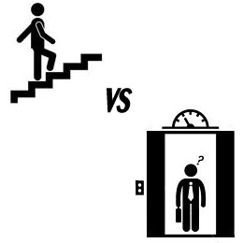
Figure 1
  Complete Figure 1 on page 351 to apply your understanding of power.

Slide 6
Goal Summery
Goal: To understand how energy, work and power are related
So, if the transfer of energy is work; power is the amount of energy that is transferred in any given amount of time.

Slide 7
Two types of Energy
Kinetic and Potential
Identifying the type of energy depends on three things:
  Motion of object
  Position of object
  Shape of object

Slide 8
Kinetic Energy
The energy an object has due to its motion is called kinetic energy
  When one object strikes another object and movies it
Kinetic energy depends on speed and mass of an object. The more speed or mass an object has, the greater the amount of kinetic energy.

Slide 9
Kinetic Example
Let’s say your friends and you are playing a game of Frisbee. First, you throw with your right hand at 14 m/s. Then with your left it reaches 11 m/s. How is the kinetic energy different in the two throws?
Now, suppose we doubled the mass of the Frisbee. How has the kinetic energy changed? Which combination of speed and weight would have the most kinetic energy?
The kinetic energy is greater when you throw with your right hand (14 m/s) because when you increase the speed of an object, you also increase its kinetic energy.
When you increase the mass of an object, you also increase its kinetic energy. The combination that would represent the greatest kinetic energy would be if you used your right hand to throw (greater speed) and used the heavier Frisbee (greater mass).

Slide 10
Calculating Kinetic Energy
Kinetic Energy = ½ X Mass X Speed²
Practice:
Complete the “Do the Math” section at the bottom of page 353.
Kinetic energy is measured using joules

Slide 11
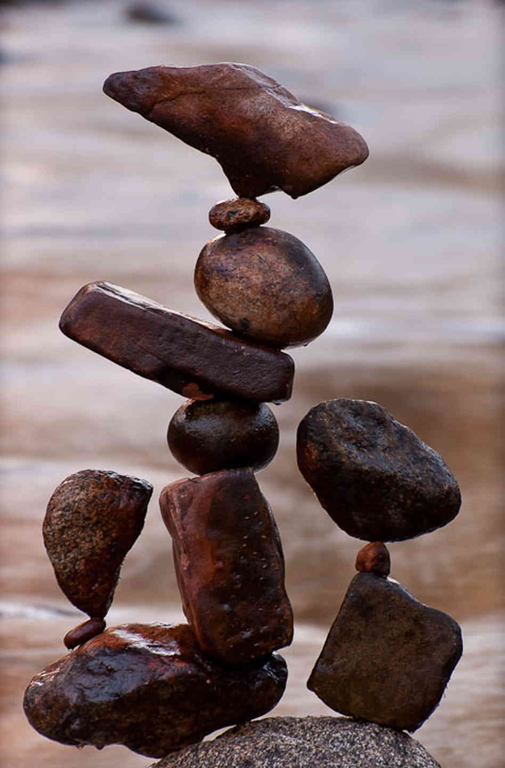
Potential Energy
If you place a book hanging at the edge of your desk, because of its shape and its position, it could fall off the desk; it has the potential to do work.
Potential Energy is energy that results from the position or shape of an object.

Slide 12
Types of Potential Energy
Gravitational Potential Energy is related to the height of an object.
Gravitational potential energy is relative to the amount of work done to lift it to that height.
Gravitational Potential Energy = Weight X Height

Slide 13
Types of Potential Energy
Potential energy that is due to an object’s shape, specifically that the shape can be compressed or stretched is elastic potential energy
Look at Figure 4 on page 355. When the trampoline changes shape, this compression motion stores energy. When she pushes off, the stored energy makes her bounce up.

Slide 14
Types of Potential Energy
In your notes, write or draw 2 examples of kinetic and 2 examples of potential energy.
When you are done, ask your partner to explain their drawings/written examples. You may also share yours.

Slide 15
Energy Transformations
https://www.youtube.com/watch?v=Jnj8mc04r9E&index=3&list=PL62C03F540D39410A

Slide 16
Goal Summery
Goal: To distinguish between the two types of energy; kinetic and potential.
The energy an object has because of its motion is kinetic energy. Speed and mass effect the amount of kinetic energy.
Potential energy is caused by an object’s shape or position that allows it to store energy. The two types are gravitational and elastic.

Slide 17
Exit Slip
Write the SI unit for each quantity. Use your notes if you don’t remember.
Force
Height
Work
Mass
Energy

Slide 18
Conservation of Energy
Learning Goals
To be able to find an object’s mechanical energy
To understand the Law of Conservation of Energy

Slide 19
Mechanical Energy
Mechanical energy is associated with motion, position or shape of an object.
It is a combination of an object’s kinetic and potential energy.
Mechanical Energy = kinetic energy + potential energy

Slide 20
It’s a funny thing…
Sometimes, mechanical energy can be either kinetic or potential energy only. An object may have only kinetic or only potential energy, but they both still have mechanical energy.
Complete Figure 1 on page 357 (including the “Draw Conclusions” part.

Slide 21
Goal Summery
Goal: To learn and be able to find an object’s mechanical energy
Now we know that:
Mechanical Energy = kinetic energy + potential energy
Also, objects can sometimes have only kinetic or potential energy, but they all have mechanical energy.

Slide 22
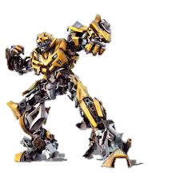
Energy Transformations
When one form of energy changes to another form, this is called an energy transformation.
              Energy transformations occur most often between potential and kinetic energy.

Slide 23
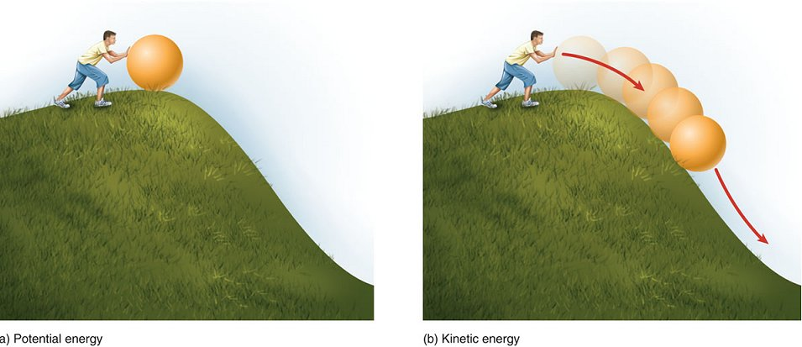
Potential to Kinetic
Falling objects- at the top of the hill, the ball has potential energy. As it rolls down the hill, its potential energy decreases, but as it gains speed its kinetic energy increases.

Slide 24
Pendulum
A pendulum describes a specific type of motion, like the one shown in Figure 3 (page 358).
Complete Figure 3 by identifying the types of energy at different points of the pendulum

Slide 25
Law of Conservation of Energy
Remember, a law is an observed pattern in nature that we are not trying to explain.
This law states that energy cannot be created or destroyed.
This means that when energy is transformed from on form to another, no energy is lost, and no extra energy is made.

Slide 26
Thermal Energy
On Earth, objects experience many forces, one of which is friction. When this happens some of its kinetic energy is transformed into thermal energy.
Thermal energy is the total kinetic and potential energy of the particles in an object.
Sometimes it is called heat energy, because that’s how we feel thermal energy.

Slide 27
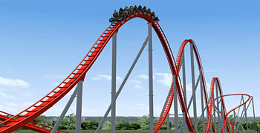
Figure 4
Complete Figure 4 (pages 360- 361) with your group.
Advanced/Gifted complete # 3: Challenge

Slide 28
Goal Summery
Goal: To understand the Law of Conservation of Energy
We know that the Law of Conservation of Energy says that energy cannot be created or destroyed. However, energy can be transformed into other types of energy; most commonly between potential and kinetic

