Slide 1
Happy Friday!
Bellwork:
Please complete the My Planet Diary on page 396 about what causes forces.
If you finish early, share your answers with a peer in your group.
Be ready to share with the class!

Slide 2
If you want to be judged for science fair:
Stand up, form a line by the door.
Everyone needs the first form.
If there are any risk factors like: using an oven, chemicals (including vinegar), sharp objects, or electrical or other equipment.

Slide 3
Today’s Goal
Today we will learn the difference between balanced and unbalanced forces. We will also be able to describe how unbalanced forces acting on an object changes its speed, direction or both.

Slide 4
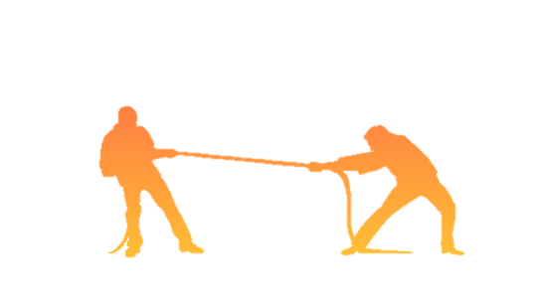
Balanced and Unbalanced Forces
If forces acting on an object are balanced, the object’s motion will not change. When the sum of all forces acting on an object is unbalanced, the object’s motion will change.

Slide 5
In other words…
If a soccer ball is sitting on the ground, both gravitational and normal forces are acting on the ball, but they are equal, so the ball does not move
When you kick the ball, you are exerting an applied force which is greater than the other two forces, causing the ball to move across the field.

Slide 6
Free Body Diagrams
A free body diagram shows all the forces acting on an object represented by arrows. The arrows point in the direction the force is pushing or pulling. These diagrams help determine whether a force is balanced or unbalanced.

Slide 8
Net Force
Net Force: the combination of all the forces on an object
This determines if an how an object will accelerate
If there are two forces pushing or pulling in the same direction, by adding them together you can find the net force
If the forces are pushing or pulling in opposite directions, you subtract to find the net force.

Slide 9
Let’s Practice!
Figure 2- Page 398
Let’s do the first one together:
Both dogs are pushing in the same direction, so we add the forces together
16 N + 10 N=
Net force of 26 N
Now, you complete the other 2 situations

Slide 10
Net Force Situation
In your notes, describe a time (or make up a circumstance) when you witnessed or were involved in a situation where the net force either caused something to move or when the forces were equal and the object did not move
Ex. Was involved in a game of tug of war. My team had less pulling force than the other team, so our team was moved ☹

Slide 11
Share with a friend! (in your group)
What is your partner’s story?
How does it represent forces?
What kinds of forces were acting on the object(s)?

Slide 12
Force Finder Activity
Look at your cards to figure out what the missing force value is to equalize the equation
When you are done, answer these questions in your notes:
Name 3 types of forces that could be at work
Did your group see a balanced or unbalanced force? How do you know?

