Slide 1
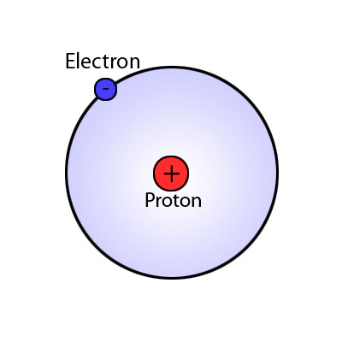
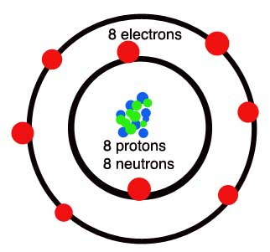
Atoms
1.) Define Atom (page 99)-
2.) What are atoms made of?
3.) Give an example of an atom in your body.
4.) Cut out the picture of the atom. Glue it onto the atoms page and color it.
Hydrogen Oxygen

